Slide 1
Causes of disease
1.3 Lifestyle and health

Slide 2
Learning outcomes
Students should understand the following:
Lifestyle can affect human health.
Speciﬁc risk factors are associated with cancer and coronary heart disease.
Changes in lifestyle may also be associated with a reduced risk of contracting these conditions.
Candidates should be able to
analyse and interpret data associated with speciﬁc risk factors and the incidence of disease
recognise correlations and causal relationships.

Slide 3
What is risk?
Risk is a measure of the probability that damage to health will occur as a result of a given hazard.
Risk has 2 elements
The probability that the event will occur
The consequences of that event
Remember that risk is about probabilities not certainties
 | Common cold | Lightening strike
Probability | High | Low
Consequences | Minor | Severe

Slide 4
Measurement of risk
Health risks need a timescale
Your risk of dying is 100%!!!
Risk is often relative
Smokers may be 15 times more likely to develop lung cancer than non-smokers .
We need to consider other factors:
Time period, number of cigarettes, gender, stress levels, pollution, alcohol, occupation
Misleading statistics (media headlines)
Check the facts first

Slide 5
Risk factors
Two types:
Ones we can’t control
Genes and age
Ones we can control
Lifestyle choices
Lets look at two diseases:
Cancer
Coronary heart disease

Slide 6
Cancer
What is cancer?
Uncontrolled cell division, resulting in a tumour.
Benign tumours stop growing, and remain localised, and usually present little health risk.
Malignant tumours continue to grow and spread to other parts of the body by a process called metastasis.
We can do nothing about our genes or our age but our lifestyle can expose us to environmental and carcinogenic factors.

Slide 7
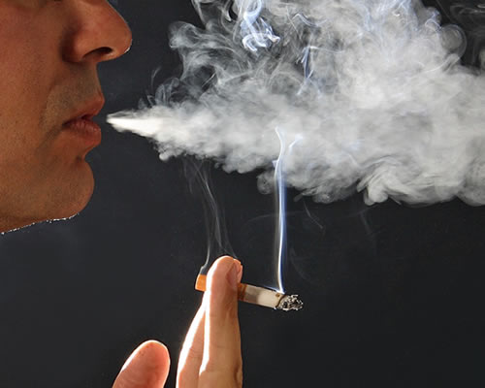
Lifestyle choices and cancer
Smoking – causes 1/3 of all cancer deaths (lung, mouth, larynx, bladder, kidney, cervix, oesophagus and pancreas). Passive smoking also increases risk.
Diet – low fat, high fibre, lots of fruit and veg reduces the risk of cancer.

Slide 8
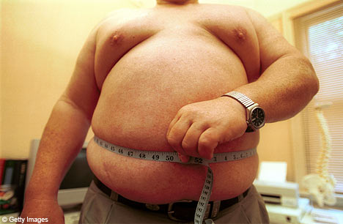
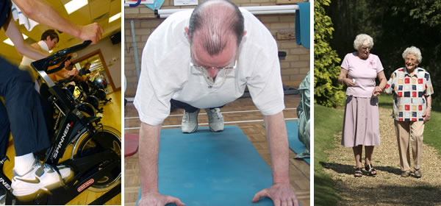
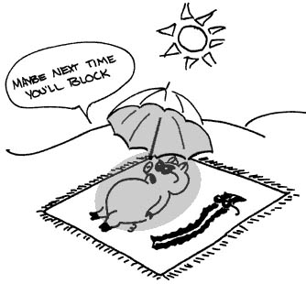
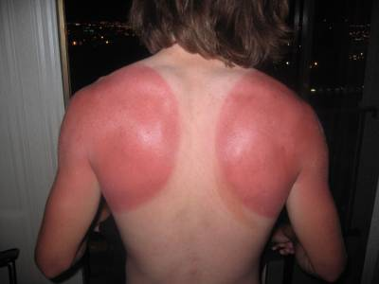
Lifestyle choices and cancer
Obesity – being overweight increases to risk of cancer.
Physical activity – reduces risk of some cancers.
Sunlight – exposure to UV light increases risk of skin cancer

Slide 9
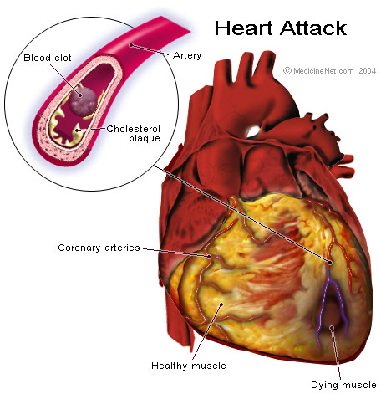
Coronary heart disease (CHD)
Build up of fatty deposits on the inner linings of arteries (atheroma).
Narrowing of the coronary arteries may restrict blood flow and starve an area of cardiac muscle of oxygen – angina
Blood clots may form in these narrowed blood vessels causing a blockage and depriving cardiac muscle of it’s blood supply. These areas of heart muscle do not function properly and my die. If the cardiac muscle does not contract this can lead to a myocardial infarction (heart attack).

Slide 10
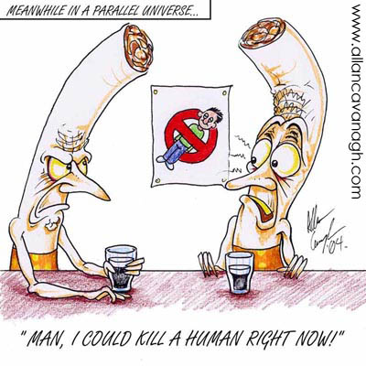
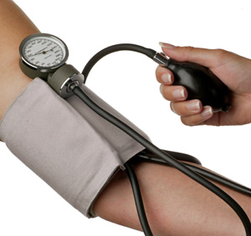
Lifestyle choices and CHD
Smoking – smokers are 2 - 6 times more likely to suffer from CHD.
High blood pressure - excessive prolonged stress, certain diets and lack of exercise all increase high blood pressure and therefore CHD

Slide 11
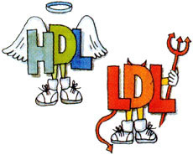
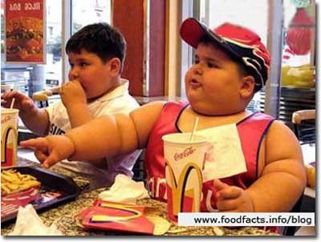
Lifestyle choices and CHD
Blood cholesterol levels –
Low density lipoproteins (LDL) from saturated fats more likely to cause atheroma.
High density lipoproteins (HDL) from polyunsaturated fats are less likely to be deposited.
Obesity – A BMI of over 25 increases risk of CHD.

Slide 12
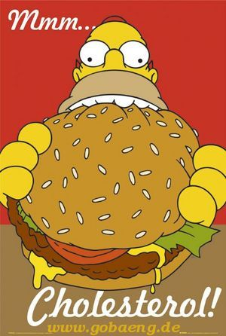
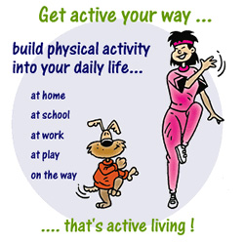
Lifestyle choices and CHD
Diet – high levels of salt raise blood pressure. High levels of saturated fatty acids increase blood cholesterol concentration. Both therefore increase the risk of CHD.
Physical activity – Aerobic exercise can lower blood pressure and blood cholesterol and reduce obesity. All of which will reduce the risk of CHD.

Slide 13
Application and How science works
Read the section ‘Smoking and disease’ (p11 – 13 )and answer the questions.
Finish for homework!

