Slide 1
12.1 – Cell Differentiation and Organisation

Slide 2
Learning outcomes
Students should understand the following:
The cells of multicellular organisms may differentiate and become adapted for specific functions.
Tissues as aggregations of similar cells, and organs as aggregations of tissues performing specific physiological functions. Organs are organised into systems.

Slide 3
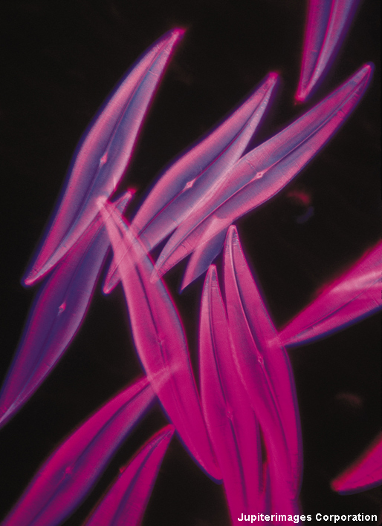
What is a cell?
A cell is the basic unit of life, from which larger structures such as tissue and organs are made.
Unicellular organisms, such as bacteria, consist of just a single cell.
Multicellular organisms consists of many cells – humans are made from an estimated 50 trillion cells!
Notes:
Photo credit: © 2007 Jupiterimages Corporation
Image shows the phytoplankton Pleurosigma angulatum. Phytoplankton are microscopic algae that live close to the surface of oceans and fresh water. Pleurosigma angulatum belong to a group of phytoplankton called diatoms, which are often unicellular.
Teacher notes
There is considerable uncertainty about the number of cells in a human body. Estimates vary from 10 trillion to 100 trillion cells.

Slide 4
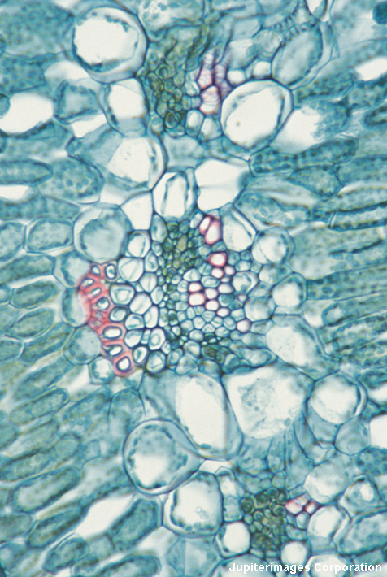
Specialised cells
Most plant and animals are multicellular. The human body is made up of around 200 different types of cell, all working together.
Most cells are specialized, meaning that each type of cell has a specific structure and function.
All cells with a nucleus contain the same genes, but different cells activate different genes so they only produce the proteins they need.
Notes:
Photo credit: © 2007 Jupiterimages Corporation
Cross section of the leaf from a Dianthus (carnation) plant. Image shows epidermis, spongy and palisade cells.
Teacher notes
Red blood cells are an example of a type of cell which has no nucleus. Gametes (such as egg cells and sperm cells) only have half a full set of genes.
See the ‘Cell Division’ presentation for more information about gametes.

Slide 5
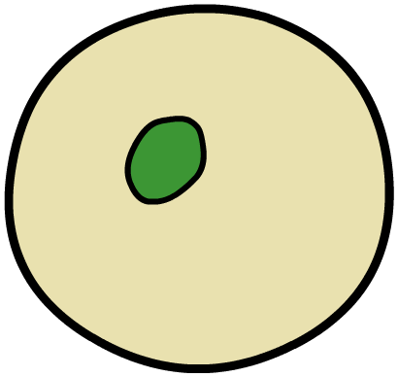
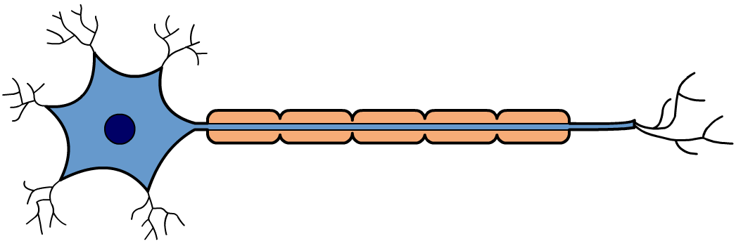
How do animal cells specialise?
In animals, the first type of cells in the developing embryo are stem cells. These are unspecialized cells that go on to form all the different cell types in the adult.
red blood cell
stem cell
sperm cell
nerve cell
muscle cell
Notes:
Teacher notes
See the ‘Growth and Development’ presentation for more information about stem cells and human growth.

Slide 6
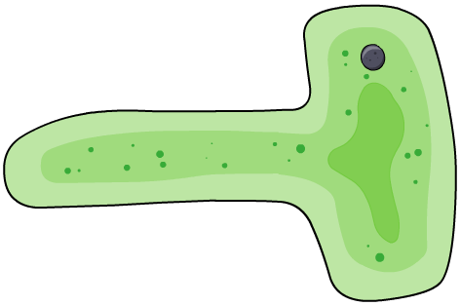
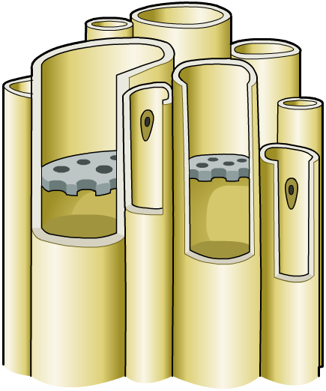
How do plant cells specialise?
Unlike animals, many plant cells retain the ability to differentiate and specialise throughout their life. These cells are found in tissues called meristems.
meristem cell
root cell
leaf cell
sieve cell
Notes:
Teacher notes
See the ‘Growth and Development’ presentation for more information about meristems and plant growth.

Slide 7
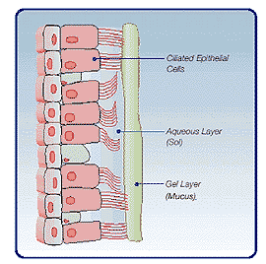
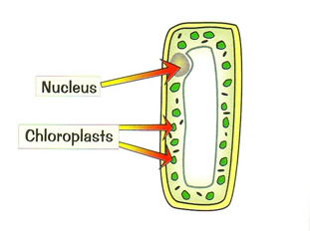
Cell differentiation
Differentiated cells are specially adapted to their function
palisade cell ciliated epithelial cell

Slide 8
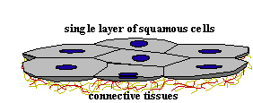
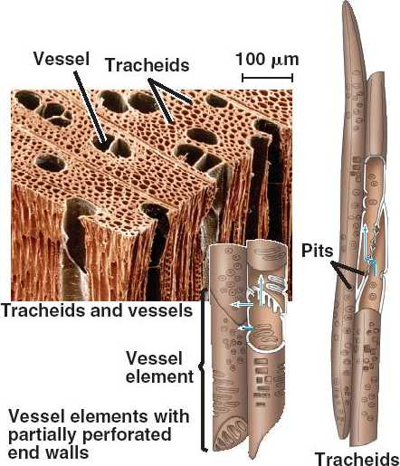
Tissues
Similar cells are grouped into tissues
Xylem – made up of a number of cells. Transports water and provides support
Epithelial tissues – single layer of flat cells lining a surfaces of organs and often have a protective or secretory function e.g. Alveoli and ciliated epithelium that lines trachea.

Slide 9
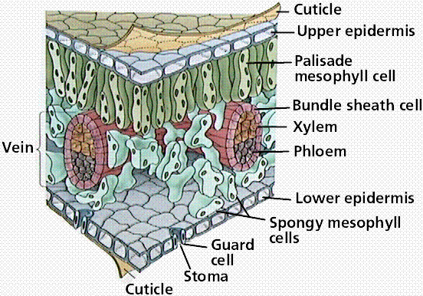
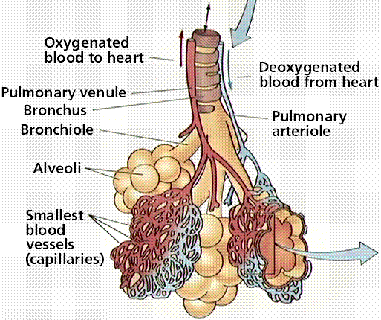
Organs
An organ is a group of different tissues that work together to perform a particular function.
Leaf Lungs

Slide 10
When is a structure an organ?
Blood capillaries are not organs but veins and arteries are. WHY?
All 3 structures have the same major function (transport of blood).
Capillaries are made up of only one type of tissue – epithelium
Arteries and veins are made up of many tissues – epithelial, muscle and connective.

Slide 11
Organ systems
Organs work together to form organ systems – each has a particular function.
Circulatory system (heart and blood vessels) – transport of gases and other substances around the body.
Respiratory system (lungs, trachea, bronchi) – gas exchange.
Digestive system (salivary glands, oesophagus, stomach, duodenum, ileum, pancreas and liver) – digests and processes food.
Shoot system (leaves, buds, stems, flowers) – all have different functions

Slide 12
Learning outcomes
Students should understand the following:
The cells of multicellular organisms may differentiate and become adapted for specific functions.
Tissues as aggregations of similar cells, and organs as aggregations of tissues performing specific physiological functions. Organs are organised into systems.

