Slide 1
UNIT 2
The variety of living organisms

Slide 2
Topics to cover
Classification
Evidence of relationships between organisms
Adaptation and selection
Biodiversity
Exchange and transport

Slide 3
14.1 Classification

Slide 4
Learning objectives
Student should understand the following:
The principles and importance of taxonomy.
Classification systems consist of a hierarchy in which groups are contained within larger composite groups and there is no overlap.
The phylogenetic groups are based on patterns of evolutionary history.
A species may be defined in terms of observable similarities and the ability to produce fertile offspring.
One hierarchy comprises Kingdom, Phylum, Class, Order, Family, Genus, Species.
Candidates should be able to appreciate the difficulties of defining species and the tentative nature of classifying organisms as distinct species.

Slide 5
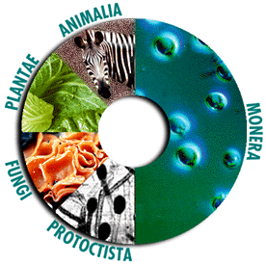
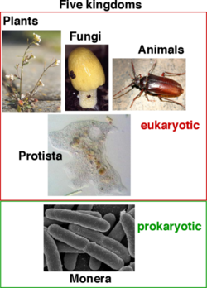
Taxonomy
Taxonomy is the science of classification:
naming organisms
organising them into groups based on their similarities

Slide 6
Naming organisms
Organisms are named according to the binomial system of nomenclature, first put forward by the Swedish botanist Carl Linnaeus.
Latin or Greek names
First name is the generic name
Second name is the specific name
Rules :
Italics if printed, underlined if hand written
First letter of generic name upper case
Specific name all lower case
If specific name is not known it can be written as ‘sp’
Human - Homo sapien Tiger – Felix tigris
Sweet pea – Lathyrus odoratus

Slide 7
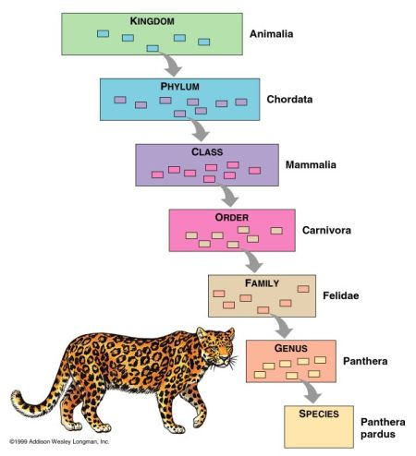
Levels of Classification
Grouping organisms
Organisms can only belong to one group in the taxonomic hierarchy.
K
P
Crisps
Only
Fry
Good
Spuds
Kingdom
Phylum
Class
Order
Family
Genus
Species

Slide 8
What is a species?
The hierarchy ends with species. A group that can contain only one organism.
A species is a group of similar organisms able to reproduce and produce fertile offspring.
Scientists constantly update the classification systems because of discoveries about new species and new evidence about known organisms.

Slide 9
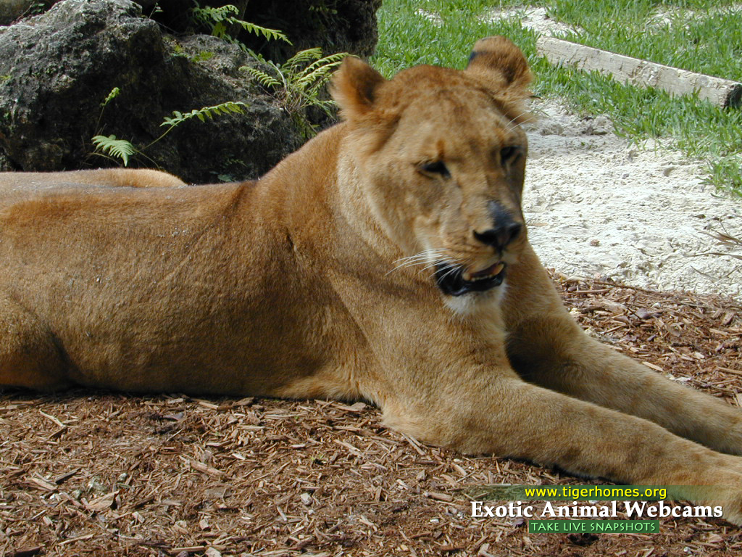
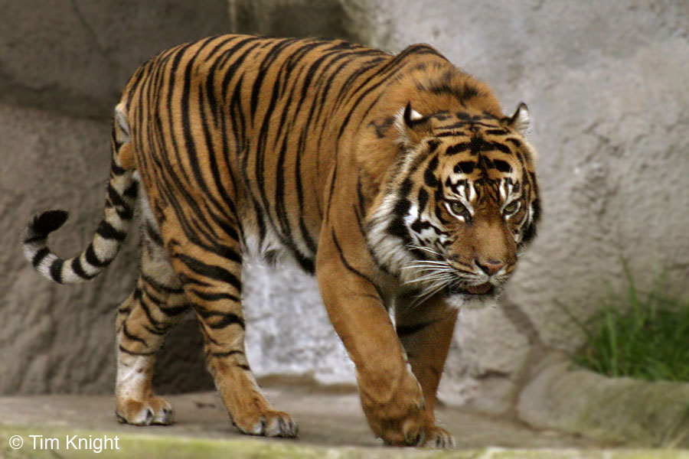
Even though they look similar, lions and tigers are different species…
Species: Panthera leo
Cannot reproduce
Species: Panthera tigris
They can breed but the offspring are infertile:
Male Female
Tiger + Lion = Tigon
Lion + Tiger = Liger

Slide 10
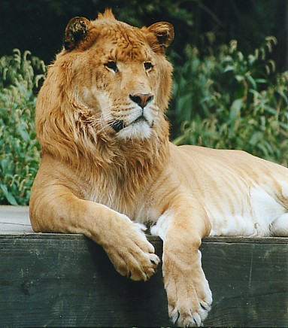
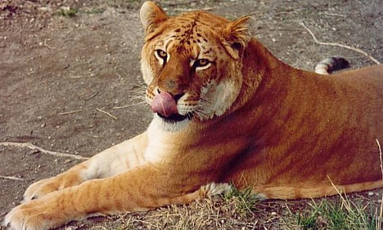
LIGER
TIGON
Liger video

Slide 11
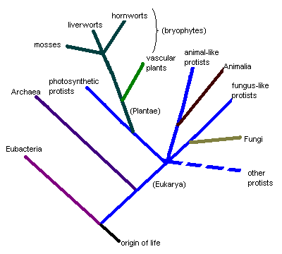
Phylogeny
Phylogeny is the study of the evolutionary history of a group of organisms.
All organisms have evolved from shared common ancestors.
Phylogenetics tells us who is related to whom and how closely related they are.

Slide 12
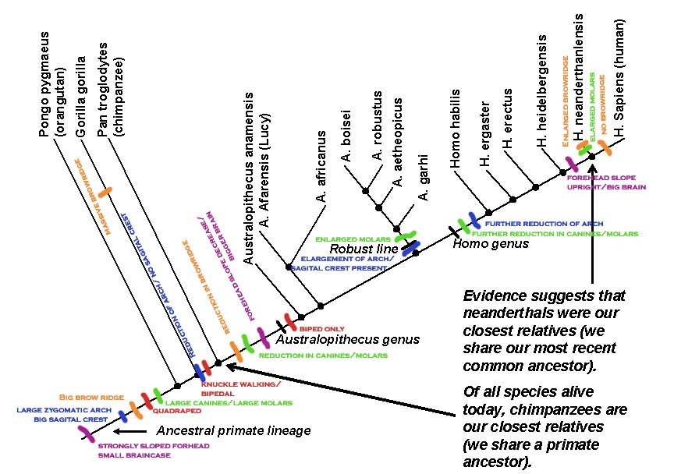

Slide 13
Difficulties with taxonomy
Species evolve over time.
Considerable variation can exists within a species e.g. Dogs – artificial selection has lead to a variety of different breeds.
You can’t always see reproductive behaviour:
Species have become extinct and there may be no fossil record.
They reproduce asexually e.g. bacteria
Practical and ethical issues
Different groups may be geographically isolated
Can’t study them in the lab

Slide 14
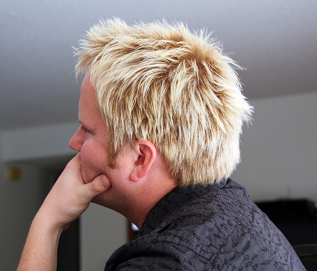
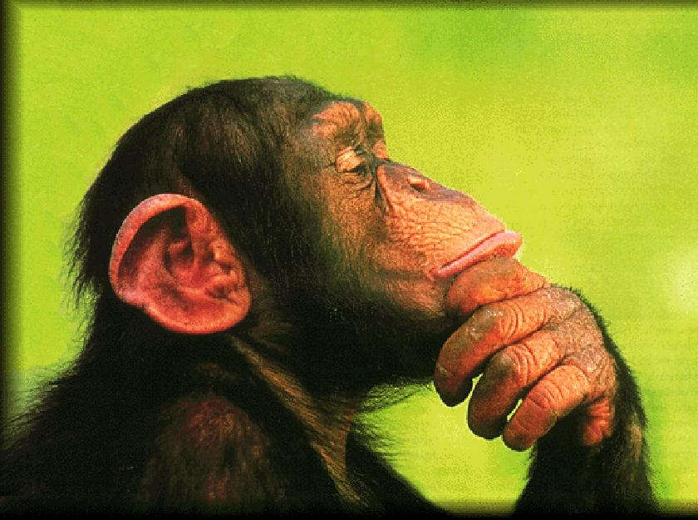
Scientist now compare the DNA of organisms to see how they are related. The more DNA they have in common the more closely related they are.
Humans and chimps share 94% of their DNA

Slide 15
Learning objectives
Student should understand the following:
The principles and importance of taxonomy.
Classification systems consist of a hierarchy in which groups are contained within larger composite groups and there is no overlap.
The phylogenetic groups are based on patterns of evolutionary history.
A species may be defined in terms of observable similarities and the ability to produce fertile offspring.
One hierarchy comprises Kingdom, Phylum, Class, Order, Family, Genus, Species.
Candidates should be able to appreciate the difficulties of defining species and the tentative nature of classifying organisms as distinct species.

