Slide 1
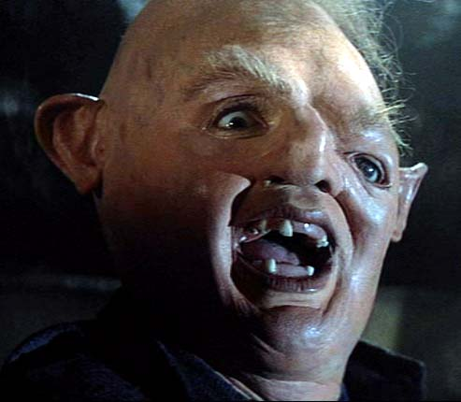
14.4 Gene Mutations

Slide 2
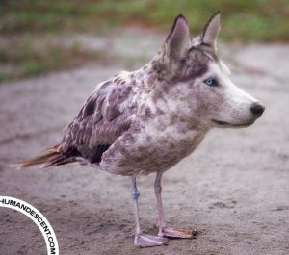
What is a Mutation?
A mutation is any change in the amount or structure of the DNA of an organism.
KEY POINT:
If this occurs in somatic (body) cells, the change cannot be inherited. Only mutations in the DNA within gametes can be passed on to the next generation.

Slide 3
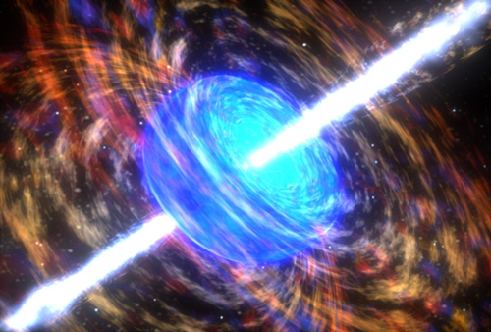
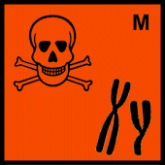
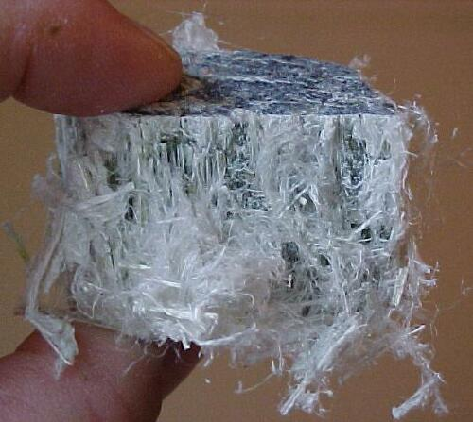
Causes of Mutations
Mutations occur naturally and at random.
However, mutagens are environmental factors that increase rate of mutation.
High-energy radiation
Mutagenic chemicals
High-energy particles from radioactive substances
Carcinogenic substances such as tar and asbestos

Slide 4
Gene Mutations

Slide 5
Point Mutations
These are point mutations involving a change of only one nucleotide at a particular locus. There are 3 types:
Substitution
One nucleotide is replaced by another with a different base.
Addition
An extra nucleotide is added so an extra base is added to the sequence.
Deletion
One nucleotide is removed.

Slide 6
Substitutions
Substitutions only affect one codon in a sequence of genetic material. They therefore only affect the outcome of a single amino acid.
The above animation is a worst case scenario when it comes to substitution mutations.
Why might a substitution mutation not have an effect on protein shape at all?
G
C
T
A
G
T
A
T
A
C
G
T
A
Arginine
Serine
Tyrosine
Tyrosine
Alanine

