Slide 1
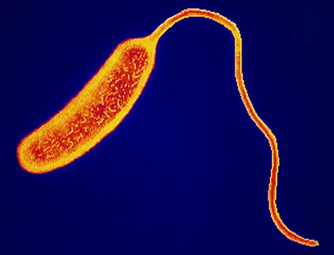
Cholera and ORT

Slide 2
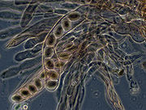
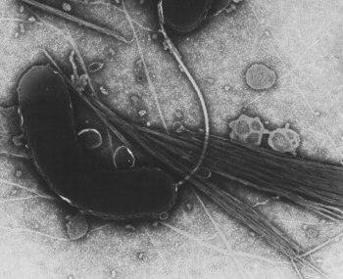
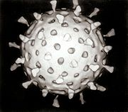
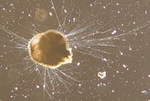
Pathogenic Microorganisms
You should already know that you live in harmony with billions of microorganisms – they live on you and in you.
The majority of these are useful and in balance.
However, PATHOGENS are microorganisms that cause disease.

Slide 3
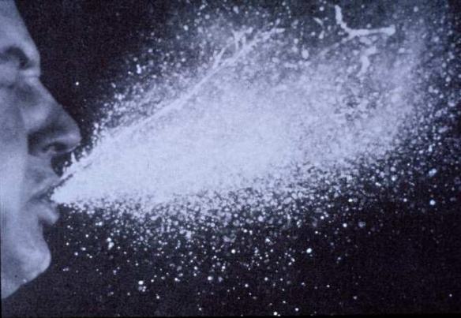
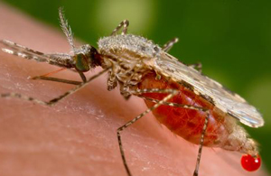
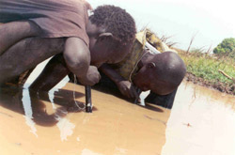
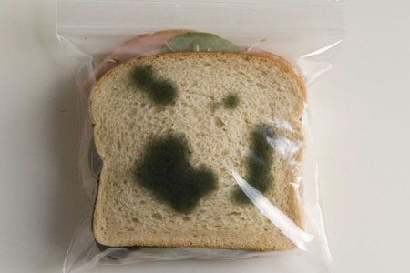
Transmission of Pathogens
Pathogens can infect an individual in a number of different ways:
AIR;
CONTAMINATED WATER;
CONTAMINATED FOOD;
DIRECT CONTACT;
VECTORS (insects).

Slide 4
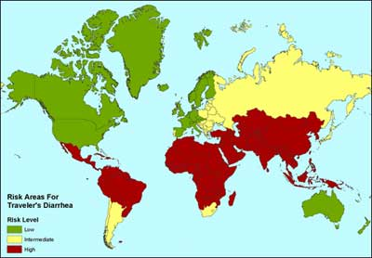
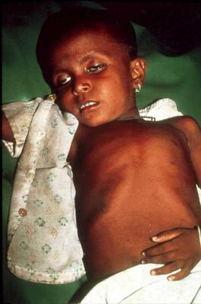
Diarrhoea
Diarrhoea affects 1 BILLION people a year and will kill 5 MILLION of these.
In developed countries, the main cause of diarrhoea are pathogenic strains of Escherichia coli.
However, in developing countries, the pathogen responsible is Vibrio cholerae.

Slide 5
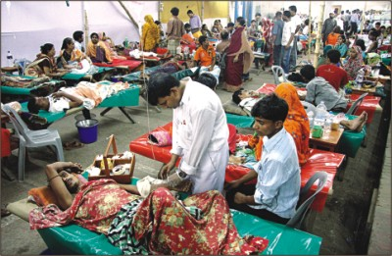
What is Diarrhoea?
Diarrhoea is the condition of passing liquid (or mostly liquid) faeces.
During a bowel movement, a vast amount of water and salts (electrolytes) are lost (and of course, the pathogen is released).
The condition causes major dehydration, which is the main cause of death in fatal cases of diarrhoea.
This year, diarrhoea will kill 1.5 million children under the age of 5.
However, a sachet costing just 5p to manufacture can save one child from dying.
These sachets are currently keeping diarrhoea-related deaths to ‘only’ 5 million, instead of 8 million per year.

Slide 6
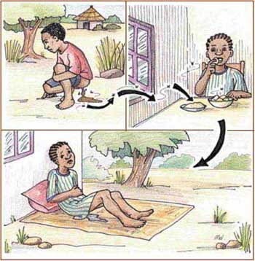

Slide 7
Although many different bacteria can cause diarrhoea, you need to learn the example of Cholera.

Slide 8
Cholera bacteria produce a toxin that affects Chloride Ion Exchange.
The bacteria produce a toxin when they infect the body. The toxin causes imbalances in the small intestine, which results in diarrhoea.

Slide 9
Lumen of the Small Intestine
Because of the drastically low water potential in the lumen. Water in the blood moves out of the blood capillaries by osmosis, across the epithelial cells and into the lumen
The massive increase in water secretion into the intestinal lumen leads to fantastic amounts of watery faeces (diarrhoea). This causes the body to become dehydrated.
Cl⁻
The toxin causes chloride ion protein channels to OPEN
Cl⁻
Cl⁻
Chloride ions move into the lumen of the small intestine. This lowers the water potential of the lumen.
Cl⁻
Cl⁻
Cl⁻
Cl⁻
Cl⁻
B l o o d

Slide 10
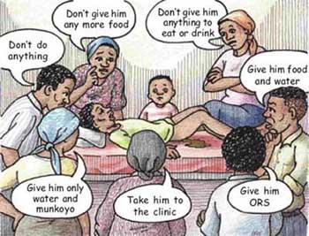

Slide 11
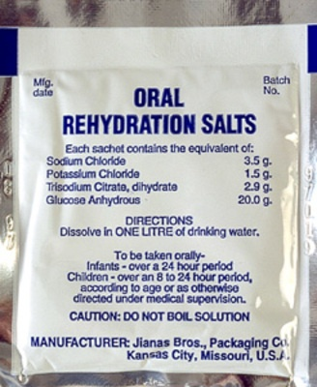
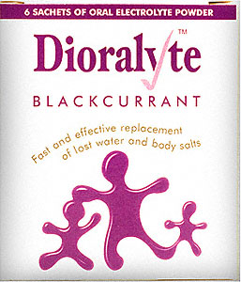
Treating Diarrhoeal Diseases (such as cholera)
People suffering from diarrhoeal diseases need to replace fluid and salts lost in their faeces.
There is an incredibly cheap and easy-to-administer treatment, known as:
Oral Rehydration Therapy
When the salts are mixed with water, the resulting solution provides an excellent way of restoring the osmotic balances in the gut.

Slide 12
Oral Rehydration Therapy (in detail)
Administering oral rehydration therapy involves preparing a drink that contains large amounts of:
Salts - chloride ions & sodium ions
Sugars - glucose & sucrose
Water
Chloride ions are obviously added to replace those lost (as mentioned).
Glucose is added to give the patient energy.
Sodium is added because the glucose cannot be absorbed without it.
Sucrose is added for fun.
The concoction is easy & cheap to make.

Slide 13
REMEMBER
Diarrhoea itself is not a disease, but merely a SYMPTOM!
Disease - Cholera
Symptom - Diarrhoea
Cause - Pathogenic Bacteria
(Vibrio cholerae)

Slide 14
