Slide 1
Immunity
6.4 B cells and humoral immunity

Slide 2
Learning outcomes
Students should understand the following:
The essential difference between humoral and cellular responses as shown by B cells and T cells.
The role of plasma cells and memory cells in producing a secondary response.
The effects of antigenic variability in the influenza virus and other pathogens on immunity

Slide 3
Defence mechanisms
Non-specific
Response is immediate and the same for all pathogens
Specific
Response is slower and specific to each pathogen
Physical barrier
e.g. skin
Phagocytosis
Cell-mediated response
T lymphocytes
Humoral response
B lymphcytes

Slide 4
Humoral immunity
The first phase of the specific response to infection is the cloning of the relevant T cells to build up their numbers.
Some of these T cells produce factors that stimulate B cells to divide.
B cells are then involved in the next phase of the specific response → humoral immunity

Slide 5
Humoral immunity
B cells are formed from stem cells in the bone marrow, they remain in the bone marrow to mature before being released into the bloodstream after birth.
There are millions of different B cells each producing a different antibody that responds to a specific antigen
An antigen is a molecule that produces an immune response e.g. a protein on the surface of a pathogen cell.

Slide 6
Humoral immunity
If a pathogen or its toxins enter the blood they encounter numerous B cells.
A few of these will carry the appropriate antibody molecule (immunoglobulin or Ig) on their surface membrane and will attach to antigens on the surface of the pathogen or toxin.

Slide 7
Humoral immunity
Given the right signals from T helper cells, the B cell divides rapidly to produce large numbers of genetically identical daughter cells i.e. clones.
Some of these daughter cells develop into plasma cells which produce and secrete up to 2000 molecules of their specific antibody per second.
Some daughter cells develop into memory cells which remain in the circulation without secreting antibodies.
B Cells animation

Slide 8
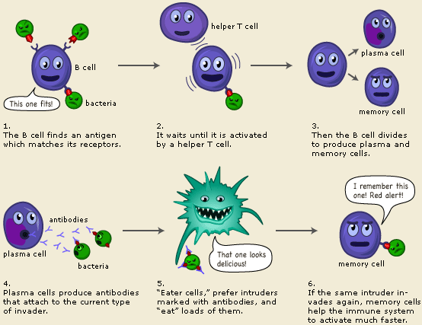

Slide 9
Primary immune response
Plasma cells secrete antibodies directly. The antibodies destroy the pathogen and any toxins it produces.
They only survive a few days but make around 2000 antibodies every second.
Plasma cells are responsible for the immediate response of the body against infection, the primary immune response.
However during the primary immune response, memory B cells are also produced.
Memory cells can live for decades circulating in the blood and tissue fluid.

Slide 10
Secondary immune response
If a second infection by the same pathogen occurs then there is a secondary immune response:
A much smaller amount of antigen will induce an immune response because memory cells are already present.
The response is much more rapid and much more antibody is produced.
The speed of the secondary response is such that the pathogen may be destroyed before infection takes hold and the symptoms may be only mild or even absent.
Memory cells provide long-term immunity against the original infection, it is known as the secondary immune response.

Slide 11
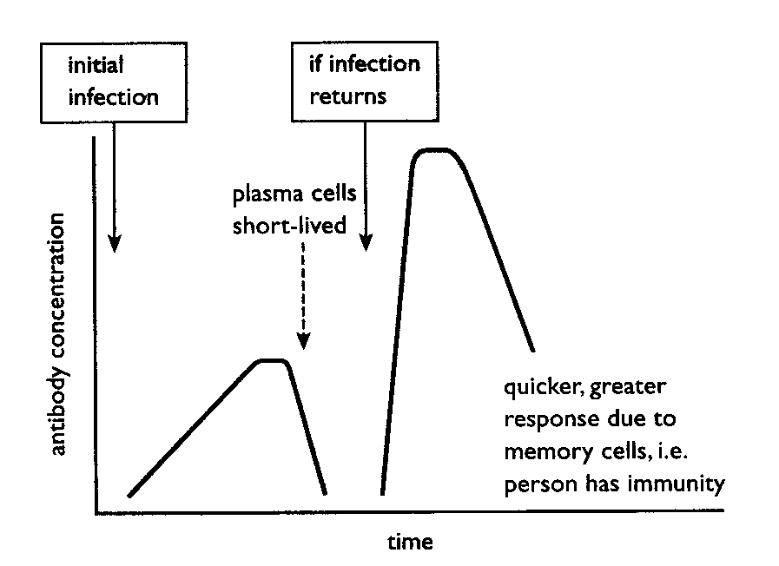
IMMUNOLOGICAL MEMORY

Slide 12
IMMUNOLOGICAL MEMORY

Slide 13
IMMUNOLOGICAL MEMORY
Primary response

Slide 14
IMMUNOLOGICAL MEMORY
Primary response

Slide 15
IMMUNOLOGICAL MEMORY
Why do people get colds and flu more than once?
Secondary response
Primary response

Slide 16
Primary and secondary responses of antibody production
Primary latent period for antibody A
Secondary latent period for antibody A
Primary latent period for antibody B
Concentration of antibody in blood
Primary
response
Primary
response
antibody A
antibody B
Time/weeks
antigen A
antigen A and B

Slide 17
Antigenic variability
Most of us only develop some diseases like chickenpox and measles once during our lifetime. The pathogens causes these are of a single type.
Pathogens like influenza have over 100 different strains. The antigens that these viruses and made of and produce are constantly changing.

Slide 18
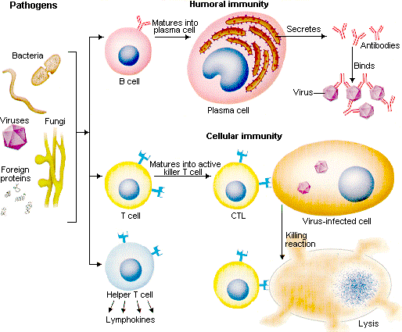
Immunity summary animation

Slide 19
Learning outcomes
Students should understand the following:
The essential difference between humoral and cellular responses as shown by B cells and T cells.
The role of plasma cells and memory cells in producing a secondary response.
The effects of antigenic variability in the influenza virus and other pathogens on immunity

