Slide 1
UNIT 2
The variety of living organisms

Slide 2
Topics to cover
Variation
DNA and meiosis
The cell cycle
Genetic diversity
The variety of life
Exchange and transport
The circulatory system of mammals

Slide 3
Variation
7.1 Investigating variation

Slide 4
Learning objectives
Student should understand the following:
Variation exists between members of a species.
Similarities and differences between individuals within a species may be the result of
genetic factors,
differences in environmental factors,
or a combination of both.
Candidates should appreciate the tentative nature of any conclusions that can be drawn relating to the causes of variation.

Slide 5
Variation
Variation can be described as differences that exist between individuals. There are 2 types
Interspecific – between different species
Intraspecific – within a species

Slide 6
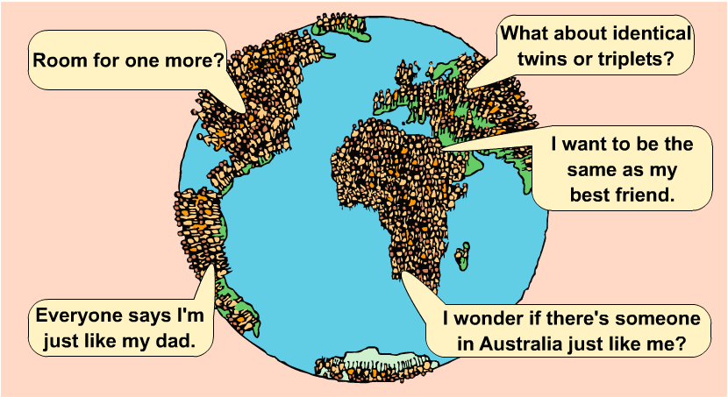
Variation within species
The current population of planet Earth is more than
six thousand million people!
No two people are exactly the same. How is this possible?

Slide 7
Variation within species
Members of the same species also show variation.
These differences are called characteristics.
How many human characteristics can you think of that
show variation?
What causes each person’s unique characteristics?

Slide 8
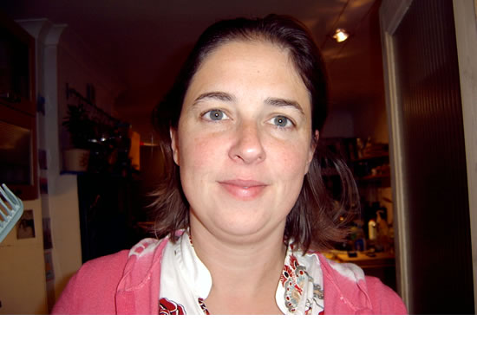
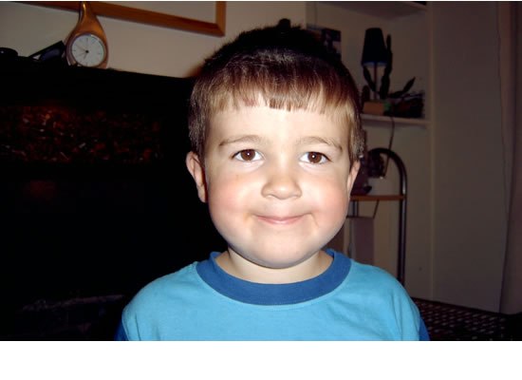
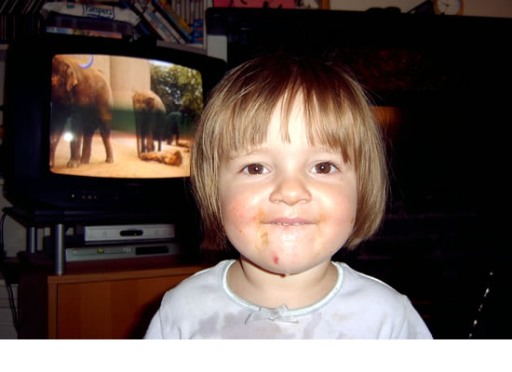
Spot the family likeness
Members of the same family often look similar.
Mum
Dad
son
daughter
Which parent do these children look more like?
If the son grows up to have children who might they look like?
Notes:
Teacher Notes
You could use these photos to initiate a discussion about family resemblances.
Suggestions for discussion:
- How are the parents similar to each other?
- How are the parents different from each other?
- How are the children are similar to each other and their parents?
- How are the children are different to each other and their parents?

Slide 9
Inherited characteristics
Why do members of the same family look similar?
Mum
Dad
son
daughter
Humans, like all living things, inherit characteristics from their parents. How are characteristics passed on?

Slide 10
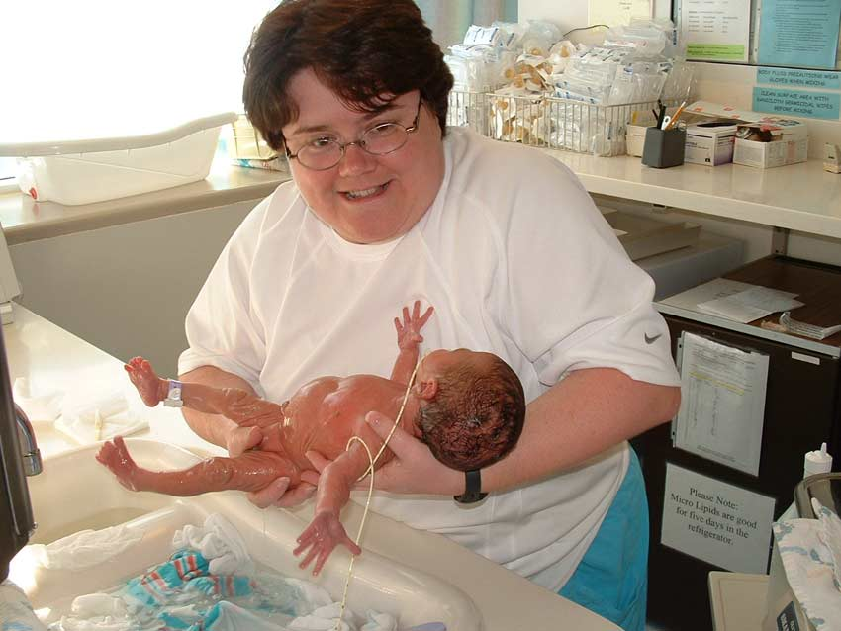
Inherited characteristics
This newborn baby’s characteristics are passed in
the genes it has inherited from its parents.
Like all babies, this little boy carries a unique set of genes, half from his mother and half from his father.

Slide 11
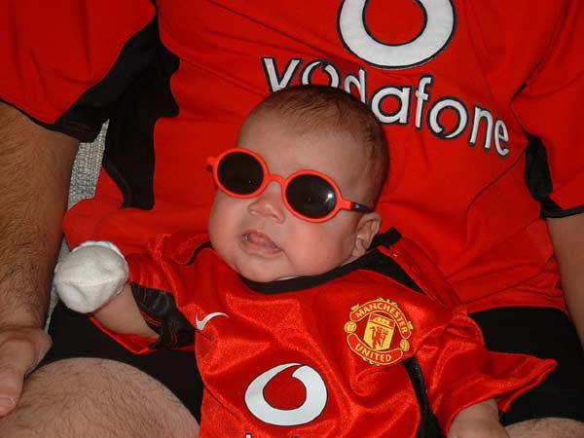
Causes of variation
People are different because they inherit different characteristics from their parents.
But are your characteristics only affected by your genes?
What else will influence the characteristics of this baby as he grows up?

Slide 12
Causes of variation
When he gets older, this baby might support a different football team (like Fulham) or not even like football.
Your upbringing and the environment in which you live also affect how you turn out as an adult!

Slide 13
Causes of variation
Your unique characteristics are caused by:
the unique set of genes you have inherited from your parents
the environment in which you have developed.
Differences in some characteristics are due to a combination of both inherited and environmental factors.
Name three examples of this type of characteristic.

Slide 14
A warning!
Be careful when drawing conclusions about the causes of variation.
Eg Overeating
Once thought only to be caused by environmental factors eg increased availability of food in developed countries.
Later discovered that food consumption increases dopamine levels, once enough dopamine was released eating would stop.
Researches discovered that people with one particular allele has 30% fewer dopamine receptors.
Therefore people with this particular allele were more likely to overeat.

Slide 15
Genetic causes of variation
Random fusion of gametes at fertilisation.
Meiosis – the type of nuclear division that forms gametes. This mixes up the genetic material before it is passed into the gametes (more on this later)
Mutations – cause a change in genes giving rise to new alleles and changes in phenotype.

Slide 16
How to classify variation
Characteristics can be classified in different ways.
How would you categorize variation in eye colour?
Could you categorize variation in height in the same way?
Variation in eye colour can be easily categorized in distinct groups. You either have a certain eye colour or you don’t.
Height variation doesn’t fall into separate groups, as it covers a range of values. Your height changes as you grow.

Slide 17
How to classify variation
Characteristics can be classified into two types:
continuous variation
discontinuous variation
A feature that can be measured and given a value from a range of values shows continuous variation .
A feature that cannot be measured but is one of a few distinct options shows discontinuous variation.
Which type of variation are eye colour and height?

Slide 18
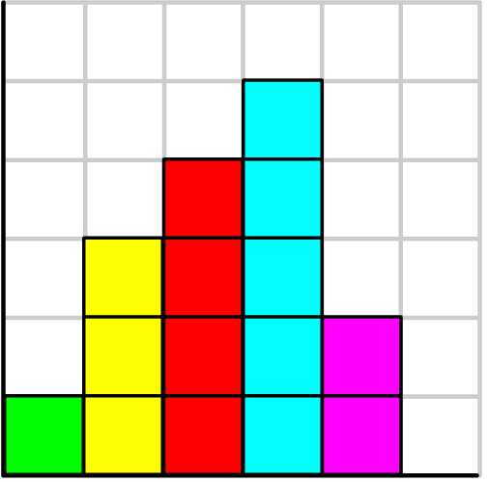
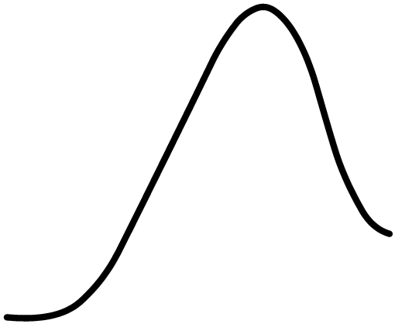
What is continuous variation?
This type of feature varies over a continuous range of values.
Examples of continuous variation include mass, height, skin colour, intelligence and leaf area.
Bar chart to show the range of
masses in a rugby team
6
5
4
3
number of rugby players
2
1
Continuous variation is due to the combined effects of a large number of genes and the environment.
0
1
70 80 90 100 110 120 130
mass (kg)
Does this mean the value of such a feature is fixed or can it change?

Slide 19
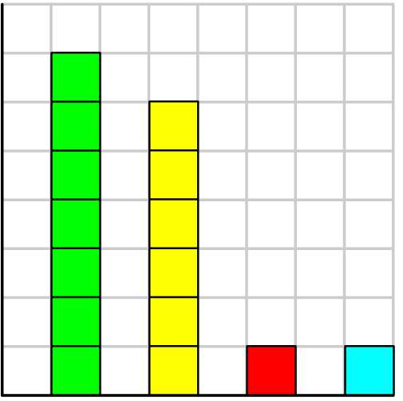
What is discontinuous variation?
This type of feature can only be one of a few distinct options. Either you have this type of characteristic or you don’t.
Examples of discontinuous variation include blood group, natural eye colour and inherited diseases.
Bar chart to show the frequency
of blood groups in a rugby team
6
5
4
3
number of rugby players
2
1
0
O A B AB
blood group
Discontinuous variation is controlled by a small number of genes with little environmental influence.
Does this mean the value of such a feature is fixed?

Slide 20
Learning objectives
Student should understand the following:
Variation exists between members of a species.
Similarities and differences between individuals within a species may be the result of
genetic factors,
differences in environmental factors,
or a combination of both.
Candidates should appreciate the tentative nature of any conclusions that can be drawn relating to the causes of variation.

