Slide 1
Sex Linkage
8.3

Slide 2
Starter
How many chromosome pairs do humans have?
23 pairs
What are the sex chromosomes and how is it determined if a person is male or female?
X and Y
Male = XY, Female = XX
Do you know any conditions that are sex linked?
Red-Green colour blindness
Haemophilia

Slide 3
Learning Objectives
Describe how sex is determined genetically
Explain sex linkage
Explain how haemophilia is inherited
Success Criteria
Complete a punnet squares for sex determination in humans, red-green colour blindness and haemophilia
Complete sheet/answer questions about pedigree charts

Slide 4
How is sex determined in humans?
Draw a Punnet square to show how sex is determined in humans
Phenotypes: 1:1 (50% male, 50% female)
Male gametes
X
Y
Female gametes
X
XX
XY
X
XX
XY

Slide 5
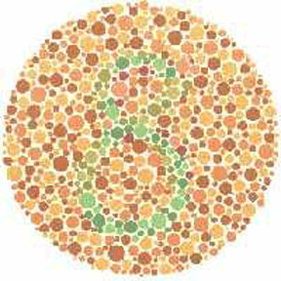
Sex Linked Diseases
Some conditions are passed on through the sex chromosomes
They are usually on the X, not Y as the X is a bigger chromosome
Red-green colour blindness
Passed on the X chromosome.
Normal sighted man = X^{B}Y
Normal sighted woman = X^{B}X^{B} or X^{B}X^{b}
Colour blind man = X^{b}Y
Colour blind woman = X^{b}X^{b}
A man only needs 1 recessive allele to be colour blind, a woman would need 2

Slide 6
Red-Green Colour Blindness
Task: draw a punnet square for a colour blind male and a normal female (homozygous dominant)
Phenotypes: All normal sighted (All females are carriers, males are normal sighted)
Male gametes
X^{b}
Y
Female gametes
X^{B}
X^{B}X^{b}
X^{B}Y
X^{B}
X^{B}X^{b}
X^{B}Y

Slide 7
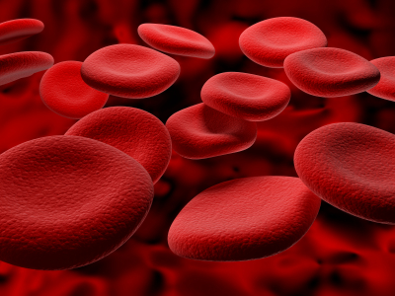
Haemophilia
Blood clots slowly (DNA is altered so that proteins required in clotting aren’t coded for) and even then there may still be internal bleeding
Potentially lethal, so the gene is relatively rare
Almost always found in males
TASK: draw a punnet square to show the cross between a carrier female and a normal male

Slide 8
Answer
Cross = carrier female and normal male
Offspring phenotypes: normal females, half males will be normal and half will have haemophilia
Genotypes: ¼ normal female, ¼ carrier female, ¼ normal male, ¼ haemophiliac male
Male gametes
X^{H}
Y
Female gametes
X^{H}
X^{H}X^{H}
X^{H}Y
X^{h}
X^{H}X^{h}
X^{h}Y

Slide 9
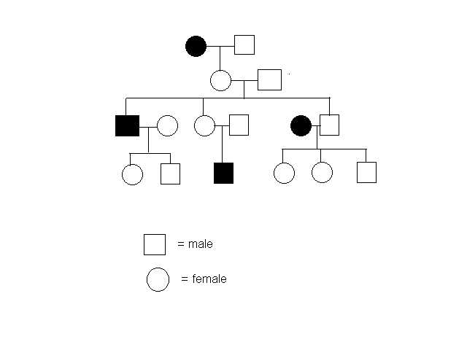
Pedigree Charts
Squares are males
Circles are females
Shading = sufferer of the disease
Dot in the circle = female carrier of the disease

Slide 10
Task
Haemophilia sheet

