Slide 1
Note: There is a practical to go with this lesson (check the lesson folder). You may want to do it as a separate lesson after teaching this.

Slide 2
Proteins and Mutations
Part 2

Slide 3
Learning Objectives
Learn how enzymes speed up reactions.
Learn how the rate of enzyme-controlled reactions can be changed.
Learn about the ‘lock and key mechanism’.

Slide 4
Success Criteria
I can list examples of where enzymes are used in the body and for other tasks.
I can explain how the active site of an enzyme is related to its function.
I can make the link between enzyme action and the lock and key theory.

Slide 5
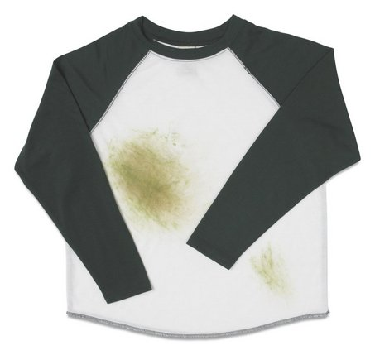
Starter
Should grass and oil stains be washed using the same laundry detergent?
There are two types of laundry detergent:
BIOLOGICAL & NON-BIOLOGICAL
Which one should be used for each type of stain, and why?

Slide 6
The Answer
Stains such as grass and blood should be washed using biological detergent.
These contain enzymes which ‘digest’ the particles in the stain.
Stains such as oil and grease should be washed using non-biological detergent as these lift the particles in a different way.

Slide 7
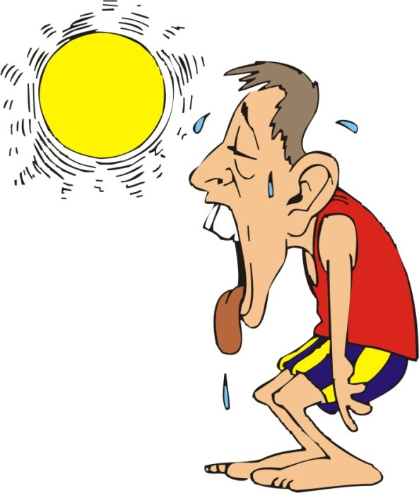
Enzymes
Some reactions in the body are very slow.
For them to happen at a faster rate, a greater temperature would be needed.
Instead, organisms use a group of proteins called ENZYMES to speed up reactions.
But raising the body temperature isn’t a good idea.

Slide 8
Make a mind-map on what enzymes are used for:
biological laundry detergent
almost every reaction in your body!
digestion
Enzymes
tenderising meat
respiration & photosynthesis
making cheese
Notes:
It is understandable that students may not have many ideas on what enzymes are used for at this stage – which is why suggestions are provided.

Slide 9
Use the animation on the next slide and the demonstration of hydrogen peroxide reacting with liver, to complete worksheet 1.
Make sure you understand the words:
Enzyme
Active Site
Substrate
Product

Slide 10
1.
enzyme
products
substrate
active site

Slide 11
Demonstration
2.
Watch what happens when hydrogen peroxide is added to a piece of liver.
The cells of the liver contain an enzyme.
The hydrogen peroxide is the substrate and is being broken down.
Make sure you understand that enzymes act as BIOLOGICAL CATALYSTS
by speeding up reactions.

Slide 12
ANSWERS to worksheet 1
A.
Enzyme
Oxygen
Protein
B.
Enzyme
Active

Slide 13
The Lock & Key Theory
The animation you saw earlier showed the enzyme and substrate to have a complimentary shape.
What does complimentary mean?
All enzymes have a uniquely shaped active site.
Only a correctly shaped substrate will fit, and react.
enzyme
substrates
Can you explain why it might be called the ‘lock & key theory’?

Slide 14
The Lock & Key Theory
Explanation:
The enzyme is the ‘lock’.
The substrate is the ‘key’.
Only one type of key will open a lock.
Similarly, only one type of substrate will fit into the active site of a particular enzyme.

Slide 15
Task
What are enzymes also known as?
Name one example of an enzyme.
What do enzymes do to chemical reactions?
Pepsin is an enzyme found in the stomach. It only breaks down proteins. Draw a diagram to show why pepsin will not break down starch.

Slide 16
pH and Temperature
Enzyme controlled reactions are affected by two conditions.
pH and Temperature
1. pH
Optimum pH – Where the enzyme works best
rate of reaction
1 2 3 4 5 6 7 8 9 10 11
pH

Slide 17
pH and Temperature
2. Temperature
Optimum temperature – where the enzyme works best
Above a certain temperature, the enzyme denatures and stops working
rate of reaction
0 10 20 30 40 50 60
temperature
Stick the handout of these two graphs in your book, and label them using the informtion on page 16 of the new textbook

Slide 18
higher

Slide 19
Denaturing Enzymes
If the conditions around an enzyme become extreme, it can cause a shape change.
At pH’s and temperatures other than the optimum, the shape of an enzyme alters.
In extreme cases, the active site changes shape and the reaction is no longer catalysed.
The enzyme has been denatured (irreversible).
Extreme pH
Enzyme is denatured!
Total shape change
Extreme Temperature

Slide 20
Q₁₀
The temperature coefficient (or Q₁₀) is the effect of temperature on the rate of reaction.
It is calculated using the formula:
Q₁₀ = rate at higher temperature
rate at lower temperature
Many enzymes have a Q₁₀ of around 2.
This means that increasing the temperature of a reaction by 10^{O}C should double the rate of the reaction.

Slide 21
Task
Biological washing powders contain enzymes. Explain why the washing powder may become ineffective at high temperatures.
An enzyme controlled reaction at 20^{O}C had rate of 5 arbitrary units. When the reaction was repeated at 30^{O}C, the rate changed to 12 arbitrary units.
Calculate the Q₁₀ for this reaction.
The high temperatures may denature the enzyme in the washing powder.
12/5 = 2.4

Slide 22
plenary

Slide 23
Imagine you have been given:
A washing machine
Biological laundry detergent
5 grass-stained t-shirts
Design an experiment to investigate the effect of temperature on the effectiveness of biological laundry detergent.
Plan in your book, and then feedback to class.

