Slide 1
The Circulatory System
Part 1

Slide 2
Learning Objectives
Learn about what blood cells are and what they do.
Learn about the different types of blood vessels.
Learn about how blood vessels are suited to their job.

Slide 3
Success Criteria
I can state the order of the blood vessels as blood is pumped around the body.
I can explain the function of the 4 components of the blood.
I can explain in detail the reaction between oxygen and haemoglobin.

Slide 4
Starter Questions
What are the cells that carry oxygen called?
Approximately how many litres of blood does the body contain?
Where are blood cells made in the body?
On average, how often does the heart beat in one minute (at rest)?
Red blood cells.
5-6 litres in an average-sized adult.
Bone marrow.
About 70 beats/min.

Slide 5
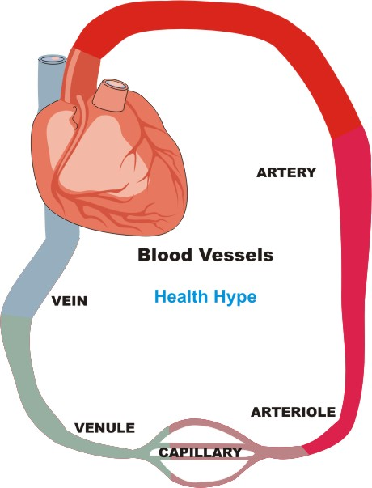
The Circulatory System
The vessels that transport the blood are called:
ARTERIES
CAPILLARIES
VEINS
The arrows shows the direction of blood flow as it leaves the heart.
Arteries pump blood away from the heart.
Capillaries join arteries and veins, and allow gases and nutrients to exchange.
Veins carry blood back to the heart.
Notes:
There is a diagram in the lesson folder that student can label with the function of each vessel.

Slide 6
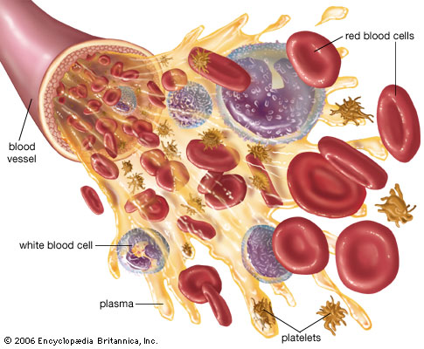
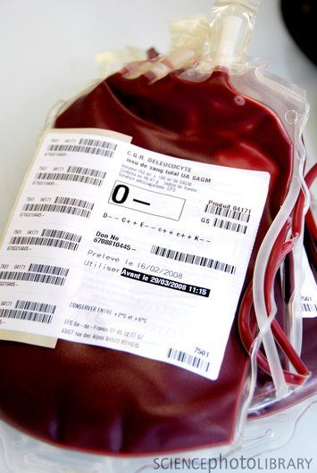
Blood Basics
Blood is a red liquid, but looks very different under a microscope.
It’s actually made of four main components that are pumped through the blood vessels.

Slide 7
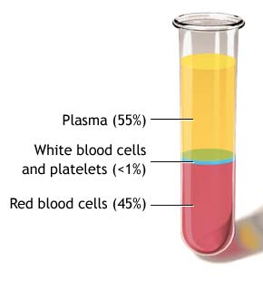
Blood Basics
The four components of blood are:
Plasma
Red Blood Cells
White Blood Cells
Platelets
If a jar of blood was left to rest for a while, it would start to separate into different layers.
The fast flow of blood keeps it well mixed in the body.
Notes:
This website: http://science-mattersblog.blogspot.com/2011/11/body-systems-cardiovascular-system.html has a fun way of describing the components of blood. Not worked into the powerpoint because not all items would be available in the department.

Slide 8
Blood Components
Copy the table into your book and then fill it in as we cover the next few slides (or use the blood fact sheet).
Part of Blood | Appearance | Job | Drawing
Red Blood Cell
Plasma
White Blood Cell
Platelets
Notes:
PLEASE READ: To complete the table, you can simply go through the next few slides which detail the components of the blood. However, for a more able class, there is a Blood Fact Sheet available from the prep room (ask Mel) that can be given to the students. They can be set the task of reading the fact sheet and using information from it to fill in the table. The relevant information is on the front-right of the sheet. A plenary activity is also available using the fact sheet. See end of powerpoint.

Slide 9
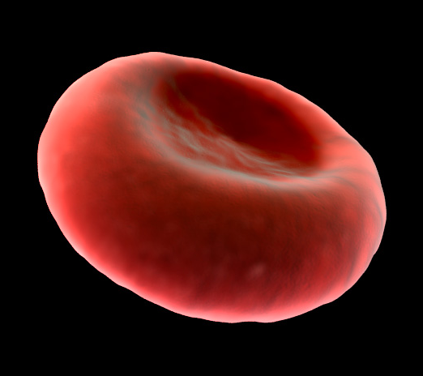
Red Blood Cells
Red blood cells carry oxygen around the body.
They are very small, allowing them to get to all parts of the body.
They are red because they contain a protein called haemoglobin, which attracts oxygen to the cell.
Red blood cells have a disc-shape.
There is a dent on both sides, which allows them to carry more oxygen.

Slide 10
Red Blood Cells (Higher)
The ‘dents’ in the red blood cells shape means the cells have a greater surface area to carry oxygen:
31
28
Notes:
The circles represent oxygen. Explain that the concave shape of the cells allow more circles to ‘fit’ on the surface compared with if the cell was flat. You may want to explain that this isn’t really how rbc’s carry oxygen, but just an explanation about surface area.

Slide 11
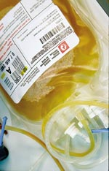
Plasma
Blood plasma is the liquid part of the blood.
It is a yellow and mostly consists of water that contains dissolved substances such as:
Nutrients
Hormones
Antibodies
Dissolves gases
Waste products
On the right is a bag of blood plasma ready to be transfused.

Slide 12
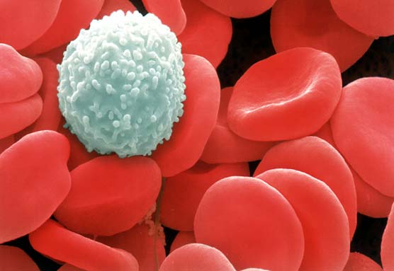
White Blood Cells
White blood cells are the largest cells in the blood.
Their job is to defend the body against disease.
White blood cells first detect foreign microbes, and then divide and produce antibodies (B1)
There are far fewer white blood cells circulating the body than red blood cells.
Can you think why?
Notes:
Answer to question right of picture: Oxygen is much more in demand and red blood cells are constantly required to deliver oxygen to respiring cells. White blood cells are not needed in a massive number as they are first required to detect pathogens, and then if required, they will divide into many cells.

Slide 13
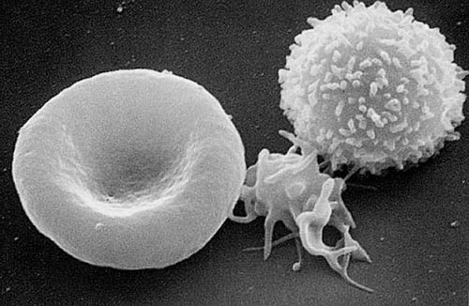
Platelets
When we cut ourselves, a scab forms over the cut.
Platelets are responsible for protecting wounds by clotting and forming scabs.
Platelets are made of tiny dead cell fragments
Your table should now be complete!
WBC
RBC
Platelet

Slide 14
Questions
Explain one way in which red blood cells are adapted to their function.
Write down the substances dissolved in and transported by the plasma.
Write down the order of the vessels a blood cell would travel through when pumped by the heart.
They have a disc-shape with 2 dents (concave) to increase surface area for carrying oxygen. OR: They contain a lot of haemoglobin, for carrying oxygen.
Nutrients, hormones, antibodies, waste products, dissolved gases.
Arteries → Capillaries → Veins.

Slide 15
higher

Slide 16
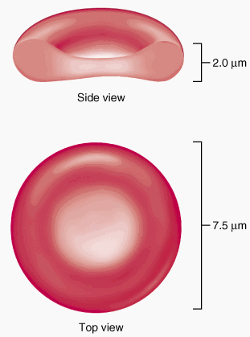
More on RBCs…
Although red blood cells are small, their concave shape allows them to have a large surface area.
Remember that haemoglobin is a protein that contains an iron group.
The haemoglobin contained in red blood cells has a very special property:
In the lungs it combines with oxygen:
Oxygen + Haemoglobin → Oxyhaemoglobin
But…
At body cells it separates from oxygen:
Oxyhaemoglobin → Oxygen + Haemoglobin

Slide 17
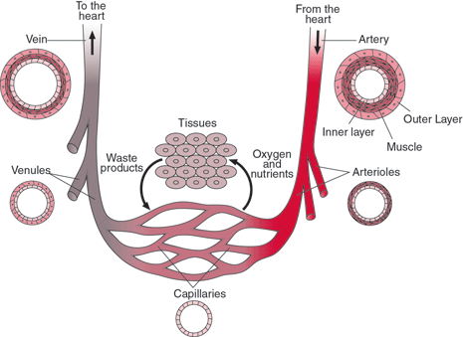
Blood Vessel Adaptations…
Arteries have thick muscular/elastic walls to withstand high blood pressure.
Veins have a large lumen to help blood flow back to the heart.
There are also valves to stop blood flowing backwards.
Capillaries have a thin, permeable wall to allow the exchange of materials.

Slide 18
Questions
Why is haemoglobin an important molecule and what makes it versatile?
Explain the differences between arteries and veins.
Why are the walls of capillaries thin and permeable?
It binds to oxygen to allow it to be carries around the body.
It is versatile because it binds to oxygen in the lungs, but separates from it at body tissue.
Arteries have thick, muscular, elastic walls to withstand high blood pressures, whereas veins have thinner walls and a larger lumen to allow blood back to the heart at low b.p.
They are thin and permeable to allow dissolved gases, nutrients and wastes to be exchanged.

Slide 19
plenary

Slide 20
Read through the blood fact sheet once again. Write a paragraph persuading people to donate blood. Explain why it so important and who could benefit. Make sure you use information on the sheet.

Slide 21
Learning Objectives
Learn about what blood cells are and what they do.
Learn about the different types of blood vessels.
Learn about how blood vessels are suited to their job.

Slide 22
Success Criteria
I can state the order of the blood vessels as blood is pumped around the body.
I can explain the function of the 4 components of the blood.
I can explain in detail the reaction between oxygen and haemoglobin.

