Slide 1
Intensive Rearing of Domestic Livestock
5.6

Slide 2
Learning objectives:
How does rearing animals intensively increase the efficiency of energy conversion?

Slide 3
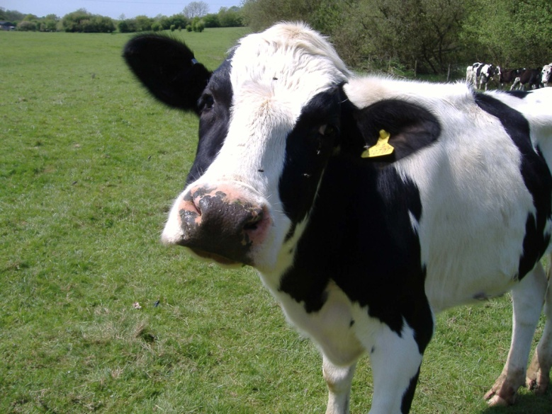
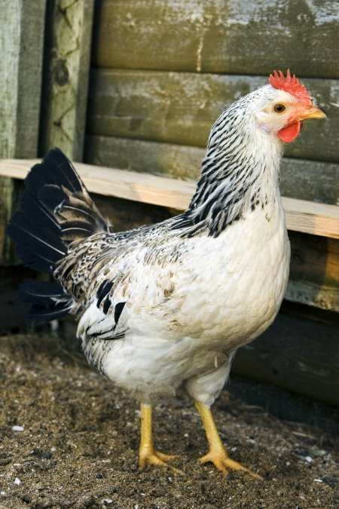
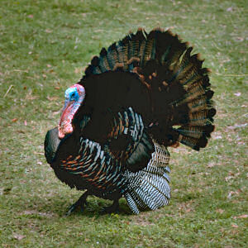
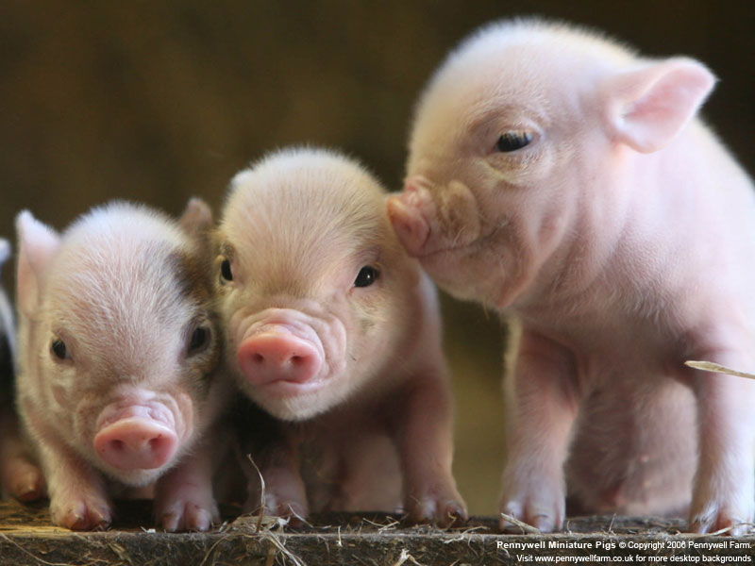
Intensive rearing of livestock
This produces the max. yield of meat, eggs and milk at the lowest possible cost.
What are the most commonly reared animals?

Slide 4
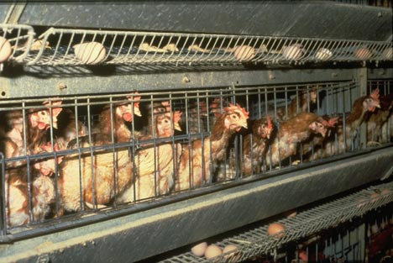
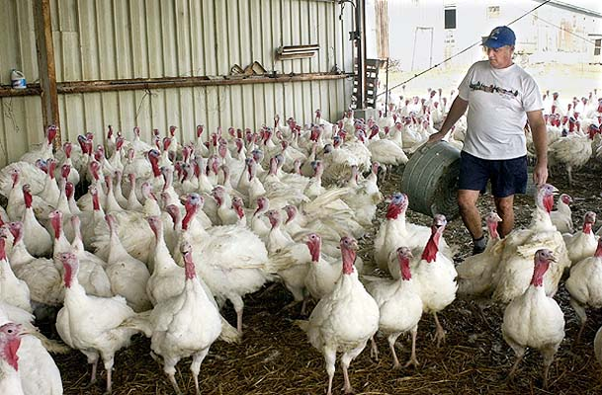
Intensive rearing and energy conversion
Energy is lost at each trophic level of a food chain e.g. Energy is lost as heat during respiration.
Intensive farming minimises energy losses, thereby converting the smallest amount of food energy into the greatest quantity of animal mass.
More efficient energy conversion is when the max. possible amount of energy from respiration goes into growth.
Animals are kept in confined spaces (barns, cages, small enclosures) – factory farming!

Slide 5
How does factory farming increase the energy conversion rate?
Movement is restricted and so less energy is used in muscle contraction.
Most ‘factor farmed animals’ are warm blooded. By keeping their environment warm, heat loss is reduced from the body.
Control feeding to ensure animals receive optimum amount and type of food for max. growth. No wastage.
No predators, therefore no loss of energy to other organisms in the food web.

Slide 6
Other mechanisms to improve the energy conversion rate?
Selective Breeding – produces animals which are more efficient at converting the food into body mass.
Using hormones to increase growth rates.
Meet the Super Cow!

Slide 7
Debate: Using pages 80-83 from the student text book prepare a debate on ‘Should Intensive Farming Be Banned?’
Fast food takeaway restaurant owner – Rob
Dinner man – Ed
Restaurant Owner (A la carte) – Sam
Zoo keeper – Lucy
Struggling single mother, 3 children, works P/T in Tesco – Charlotte.
Wealthy organic farmer – Lewis
Wealthy Intensive farmer –Bronwyn
Successful Lawyer, 5 children – Kate
Student at Leicester University, Maths Student, 2nd year - Greg
Butcher - Nikita
Middle aged Hippy & Green peace Supporter - Wa Wei

