Slide 1
P4: Radiation for Life
Lesson 15:
Fission and Fusion
(part 1)

Slide 2
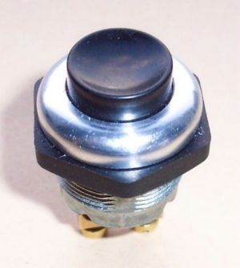
Starter
What’s today’s lesson about?
Just watch and see!

Slide 3
Lesson Objectives
Understand the main stages in the production of electricity in nuclear power stations.
Describe nuclear fission and how it is controlled.

Slide 4
Success Criteria
Grade E | Grade C | Grade A
Describe the main stages in the production of electricity | Describe how electricity is generated at a nuclear power station | Describe what happens to allow uranium to release energy
Describe the process that gives out energy in a nuclear reactor | Understand how the decay of uranium starts a chain reaction | Explain what is meant by a chain reaction
Recall that nuclear fission produces radioactive waste |  | Explain how to stop nuclear reactions going out of control
Key Words:
fission • fusion • nuclear • chain reaction • graphite moderator •
control rods • uranium • reactor

Slide 5
Nuclear power stations
These work in a similar way to normal power stations:
The main difference is that the nuclear fuel is NOT burnt – it is used to boil water in a “heat exchanger”

Slide 6
Nuclear power stations use ‘Nuclear Fission’.
‘Enriched’ uranium (i.e. uranium which contains a much greater proportion of U-235, than U-238, than occurs naturally) forms the ‘fuel rods’ in the nuclear power station.
A very large amount of heat is generated when large unstable nucleii are split up and this is used to heat water, to boil steam, which turns a turbine, which turns a generator, which produces electricity!
So how does uranium release energy?

Slide 7
Group Work
Foundation
Use pages 260 and 261 in the book (blue section)
to briefly explain how a nuclear power station
works.
Explain what is meant by a chain reaction.

Slide 8
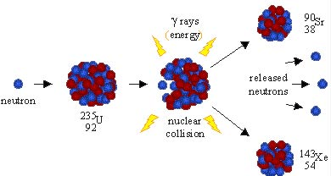
Higher
²³⁵U₉₂ + ¹n₀ ⁹⁰Sr₃₈ + ¹⁴³Xe₅₄ + γ rays
Uranium-235 nucleii do not always split in the same way but extra neutrons are always produced. This starts a ‘chain reaction’.

Slide 9
Controlling Nuclear Fission
Higher
In groups of 5, use page 261 in the textbook to role
play a chain reaction and explain the need for
controlling nuclear fission.
How is nuclear fission controlled?

Slide 10
Plenary
Using a flow diagram, draw the stages involved in
the production of electricity within a power station.
What is the difference between the generation of
power in a nuclear power station and that of a
regular power station.

Slide 11
Success Criteria
Grade E | Grade C | Grade A
Describe the main stages in the production of electricity | Describe how electricity is generated at a nuclear power station | Describe what happens to allow uranium to release energy
Describe the process that gives out energy in a nuclear reactor | Understand how the decay of uranium starts a chain reaction | Explain what is meant by a chain reaction
Recall that nuclear fission produces radioactive waste |  | Explain how to stop nuclear reactions going out of control
Key Words:
fission • fusion • nuclear • chain reaction • graphite moderator •
control rods • uranium • reactor

