Slide 1
Starter MHW6
What is a diode?
Draw a diagram to show the circuit symbol for a diode

Slide 2
P6 – Electricity for Gadgets
Lesson 15 – Diodes
Learning aim: Demonstrate an understanding of how diodes work

Slide 3
Learning Objectives
Success Criteria
Recognise symbol for a diode and understand how it works.
Understand half-wave rectification.
Recognise and explain the current voltage graph for a silicon diode.
Recognise and draw the symbol for a diode and how current flows through the diode. (Grade E-D)
Recognise half-wave rectification from a voltage–time graph.(Grade E-D)
Recognise the current–voltage characteristics for a silicon diode and use it to explain the direction of current flowing through the diode. (Grade C)
Recall and identify the effect of a single diode on alternating current. (Grade C)
Explain the current voltage graph for a silicon diode. (Grade C-A)
Describe the action of a silicon diode in terms of the movement of holes and electrons.(Grade C-A)

Slide 4
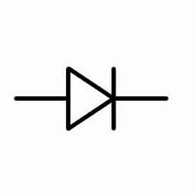
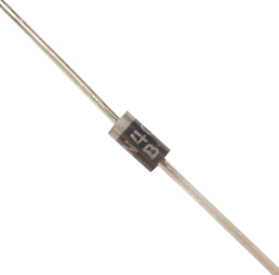
The diode
The symbol for a diode is:
In reality it looks like:

Slide 5
MHW8 Revise P6 ready for assessment
1. What are the equations for :
Resistance
Electrical power
What is the purpose a the split ring commutator in a motor?
List two things that will effect the size of the current produced by a generator
Why do transformers only work with A.C.?
4. Why is electrical power sent down power cables at high voltages?
Notes:
Questions are to get students thinking about areas covered

Slide 6
Pg260 Diodes
What do diodes do?
Draw a diagram to show how they can change AC into DC. Show the wave traces on the input and output.

Slide 7
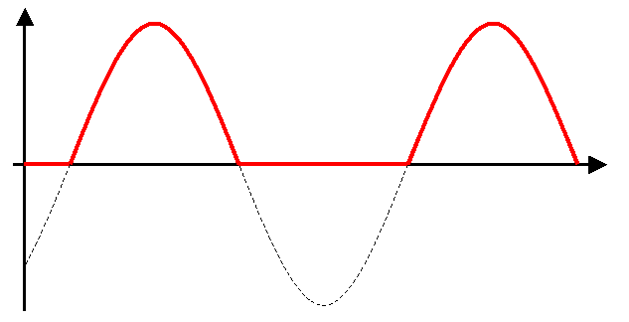
Half wave rectification

Slide 8
Experiment – V-I characteristics of a diode
Build the following circuit.
Vary the voltage of the power supply (between 0 and 12V) and measure V and I. Calculate R. Produce a results table.
Do the experiment again with the diode the opposite way around
Draw a graph of V against I
mA
V

Slide 9
Diode Experiment - Conclusion
Describe the shape of the graph obtained.
Is the diode an ohmic conductor? Explain your answer.
Describe in detail how the resistance of the forward biased diode changes as the potential difference across it is increased.
What happened when the diode was reversed?
What does this tell you about a diode?
What was the purpose of the fixed resistor?

Slide 10
Diodes - Theory
Diodes allow electricity to flow in only one direction. The arrow of the circuit symbol shows the direction in which the current can flow.
The reason for this is that the resistance of the diode is extremely low in the forward direction and extremely high in the reverse direction.
Diodes can be used in rectification circuits (circuits which change AC electricity into DC electricity)

Slide 11
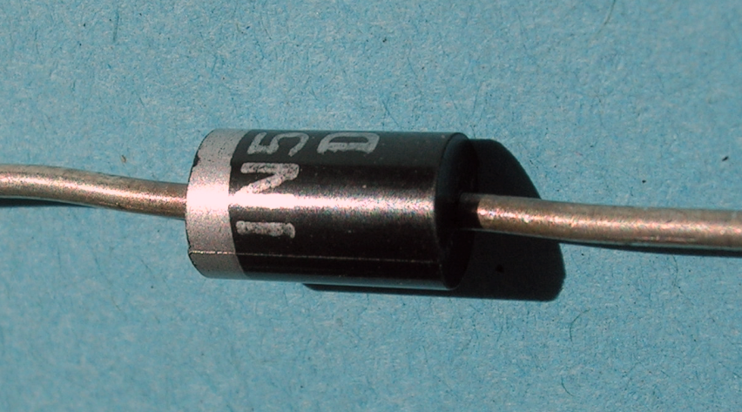
Diodes
A diode is a component that allows a current to flow in one direction only.
It has a low resistance in one direction and a very high resistance in the other.
Current flows in the direction with low resistance but is not proportional to the voltage.
If the voltage is reversed or the diode is connected the other way around, the high resistance of the diode ‘blocks’ the flow of current.
x
Current / A
x
x
x
x
x
x
x
x
Voltage / V
No current flows

Slide 13
Assessment booklet
Complete the data question

Slide 14
How diodes work – (you will need to complete a sheet to explain this after listening to the explanation)
At the junction, free electrons from the N-type material fill holes from the P-type material. This creates an insulating layer in the middle of the diode called the depletion zone.

Slide 15
How diodes work

Slide 16
How diodes work
When the positive end of the battery is hooked up to the N-type layer and the negative end is hooked up to the P-type layer, free electrons collect on one end of the diode and holes collect on the other. The depletion zone gets bigger and no current flows.

Slide 17
Plenary – Diode worksheet
HT
Use the information you have just heard and from page 261 in the text book to write explanations next to the three diagrams on the worksheet. (the central one is already done for you)

Slide 18
What is happening in this graph and why?
Plenary
Draw a current -voltage graph for a diode
What does the shape of the graph show
Notes:
LD/SD plenary alternative

Slide 19
Learning Objectives
Success Criteria
Recognise symbol for a diode and understand how it works.
Understand half-wave rectification.
Recognise and explain the current voltage graph for a silicon diode.
Recognise and draw the symbol for a diode and how current flows through the diode. (Grade E-D)
Recognise half-wave rectification from a voltage–time graph.(Grade E-D)
Recognise the current–voltage characteristics for a silicon diode and use it to explain the direction of current flowing through the diode. (Grade C)
Recall and identify the effect of a single diode on alternating current. (Grade C)
Explain the current voltage graph for a silicon diode. (Grade C-A)
Describe the action of a silicon diode in terms of the movement of holes and electrons.(Grade C-A)

