Slide 1
P4: Radiation for Life
Lesson 1:
Sparks (part 1)

Slide 2
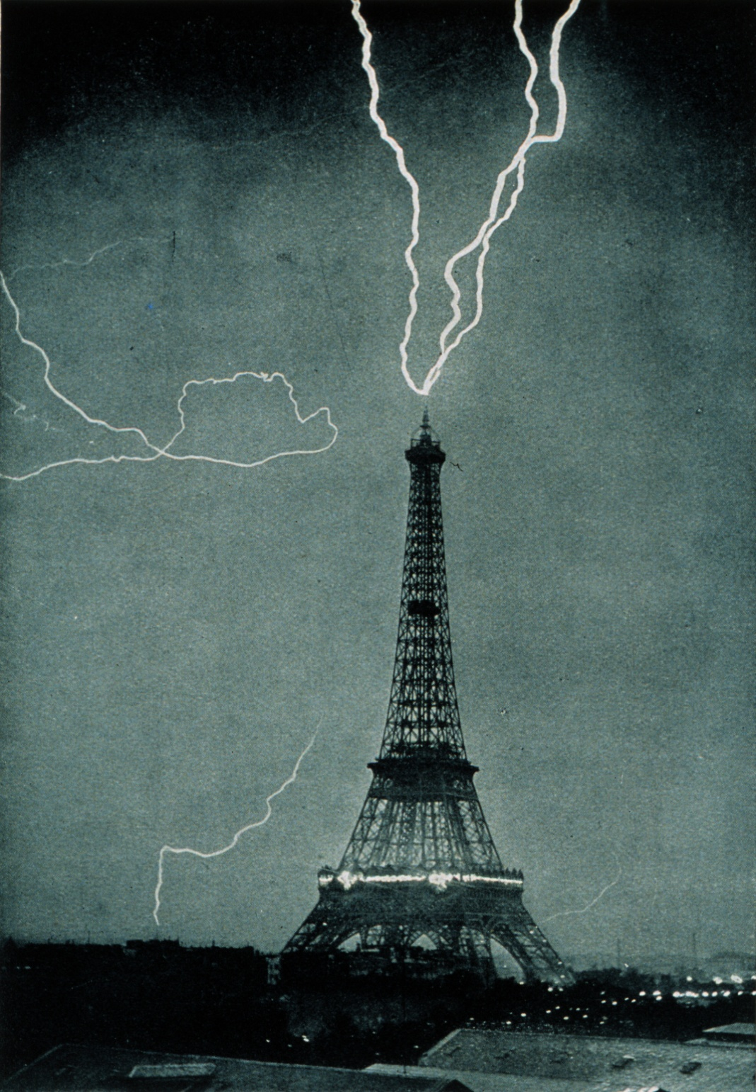
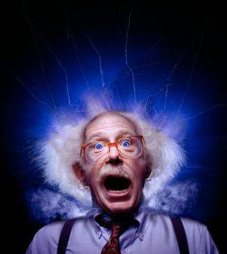
Starter How could this have happened?

Slide 3
Lesson Objectives
Understand how insulating materials can become charged.
Recognise that there are two types of charge and describe how these interact.
Realise that charged objects contain ions.

Slide 4
Success Criteria
Grade E | Grade C | Grade A
Describe how insulating materials can become charged | Recognise that like charges repel and unlike charges attract | Describe static electricity in terms of electron movement
 | Understand that electron transfer causes electrostatic effects
Key Words:
electron • positive • negative • attract • repel • insulator • conductor

Slide 5
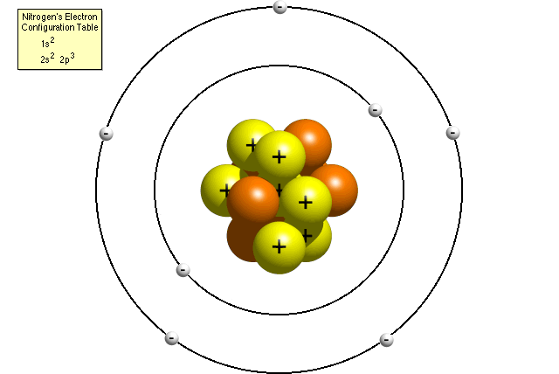
The structure of an atom
So what happens if we rub an electron off the atom?
Nitrogen ¹⁴N₇
Can you draw this?
Number of protons = Charge =
Number of electrons = Charge =
Number of neutrons = Charge =

Slide 6
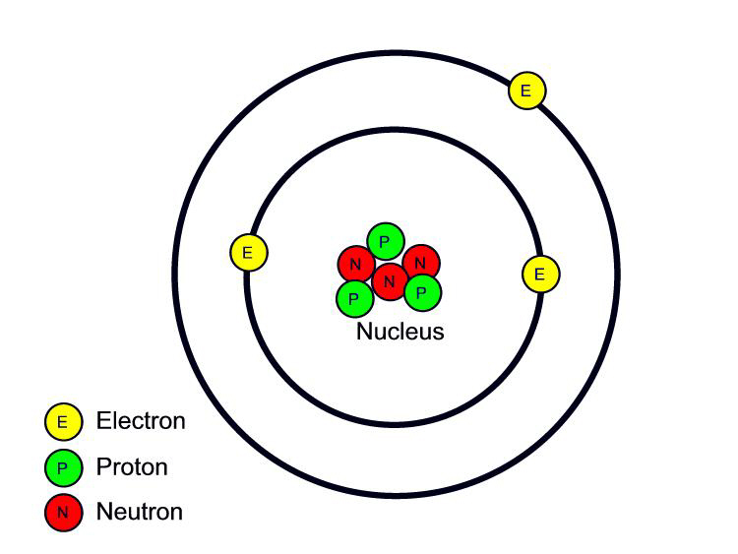
Electric charge
Electric charge can be either positive or negative.
In an atom an electron has a negative charge that is of the same size as the positive charge of a proton.
Neutrons have no electric charge.
As an atom has the same number of electrons as protons, it is uncharged (neutral)

Slide 7
STATIC
So what’s it all about then?
Let’s try some experiments and find out, eh?

Slide 8
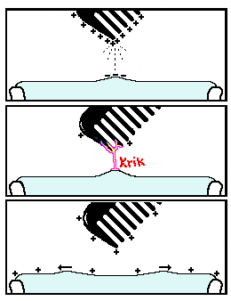
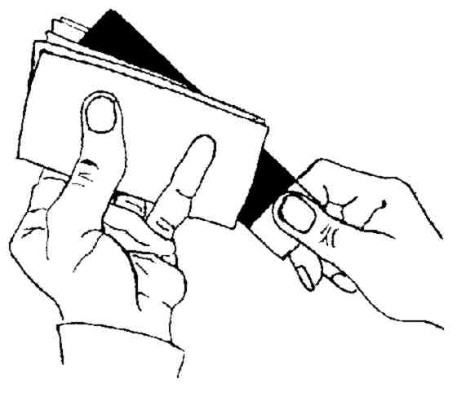
Each pair will be provided with a cloth and a rod/comb/balloon
Using your cloth, rub your rod/comb vigorously and move your rod/comb/balloon slowly towards the following:
Small pieces of paper
Running water out of the tap
Electroscope (if available)
Note down any observations!

Slide 9
Investigating static electrical charge
Work on your own and answer the following questions based on your observations.
1. List the materials that can become charged when rubbed with a cloth.
________________________________________________________________________
2. What do all of these materials have in common?
________________________________________________________________________
3. When objects are charged what can they do to uncharged objects?
________________________________________________________________________
4. How could static attraction be used in the design of dusting cloths?
________________________________________________________________________
5. What are the two types of charge called?
________________________________________________________________________

Slide 10
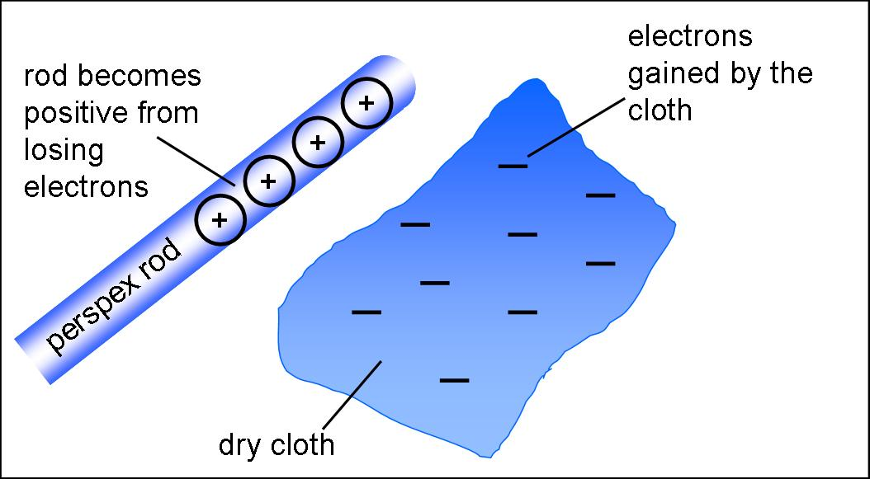
Charging materials
When certain insulating materials are rubbed against each other they become electrically charged.
Electrons are rubbed off one material onto the other.
The material that gains electrons becomes negatively charged.
The material that loses electrons is left with an equal positive charge.

Slide 11
Charging Materials
Higher
When a polythene rod is rubbed with a duster
electrons are transferred from the duster to the
Polythene... As seen in the picture below.
When an acetate rod is rubbed with a duster the
opposite happens.
What is the overall
Charge on each rod.

Slide 12
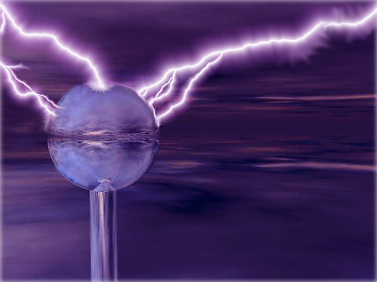
And now….
PLAY TIME

Slide 13
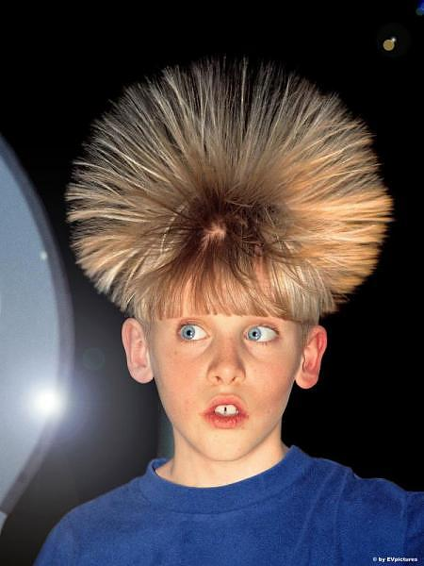
Attraction and repulsion
Two bodies that carry different types of charge attract.
Two bodies that carry the same type of charge repel.
The law of charges:
LIKE CHARGES REPEL, UNLIKE ATTRACT.
This boy’s hair has all the same type of charge!

Slide 14
Behaviour of charges
Copy the passage and fill in the gaps to summarise how charges behave:
words to use:
attract insulators charged move same opposite
When you rub a plastic rod with a cloth it becomes ___________.
We call this charging by friction and it only works with _____________ because the charges will stay in one place.
If you rub a conductor the charges can ______________ through it so they will not build up on one place.
When the insulator is charged it can ________ other objects which are not charged.
This is why your hair sometimes sticks to a comb or a rubbed balloon can stick to the wall.
Two charged objects will either attract each other if they have been given ____________ charges or repel each other if they have been given the _______ charge.
Notes:
Available as a worksheet

Slide 15
Plenary
What is required to charge an insulator?
There are two types of electric charge, what are they?
Complete the following table:
Higher
Explain, in terms of electron movement, how positive and negative charges are formed.
+ | - | attract
+ | +
- | -
- | +

Slide 16
Success Criteria
Grade E | Grade C | Grade A
Describe how insulating materials can become charged | Recognise that like charges repel and unlike charges attract | Describe static electricity in terms of electron movement
 | Understand that electron transfer causes electrostatic effects
Key Words:
electron • positive • negative • attract • repel • insulator • conductor

