Slide 1
P4: Radiation for Life
Lesson 2:
Sparks (part 2)

Slide 2
Starter
There are two types of charge. What are they?
Friction produces static charge. How?
What is an electron?
An atom has four protons and five neutrons. How many electrons has it?
With reference to the last question. Why?
Lightning is caused by a movement of charge. Which charge?

Slide 3
Lesson Objectives
Describe how electrostatic charge can be a nuisance and sometimes even dangerous.
Explain how problems caused by electrostatic charge can be minimised.

Slide 4
Success Criteria
Grade E | Grade C | Grade A
Describe how you get an electric shock from charged objects | Explain how static electricity can be dangerous | Explain how the chance of receiving an electric shock can be reduced
Describe how you get an electric shock if you become charged and then earthed | Explain how static electricity can be a nuisance | Explain how the problems of static electricity can be reduced
Key Words:
atom • electron • charge • friction • induction • attract • repel • electrostatic

Slide 5
Discharging an object
A charged body can be discharged by connecting it to the ground with a conductor.
Charge then flows through the conductor.
This process is also called ‘earthing’.
A person is usually a good enough conductor to enable an object to be discharged.
negatively charged object
object discharged
negative charge flows to earth
insulator
ground / earth

Slide 6
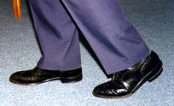
An electrostatic shock can be an inconvenience or a down-right danger!!
A person gets an electrostatic shock if they become charged and then become earthed. For example, a person can become charged if they walk on a nylon carpet or vinyl floor because:
The floor is an insulator
They become charged as they walk due to friction
The person can then become earthed by touching pipes or even another person and the speed of discharge can cause a spark causing the person to ‘jump’.

Slide 7
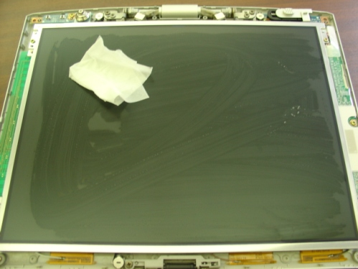
And these are other ‘minor’ inconveniences
Which are caused in the same way…
a. Dust and dirt are attracted to insulators such as
a television screen and have to be regularly wiped
clean
b. Clothes made from synthetic materials often ‘cling’ to each other and to the body

Slide 8
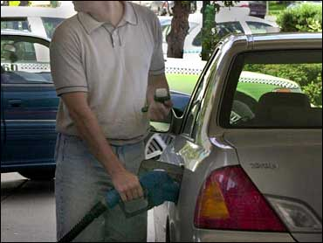
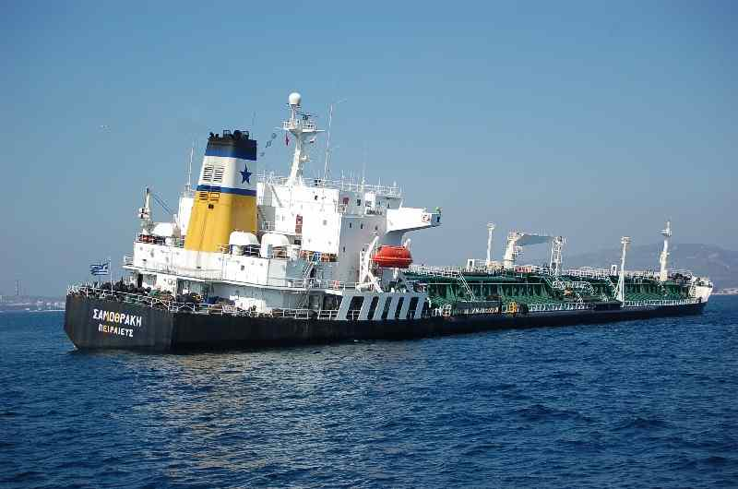
And how about this?
Inflammable gases or vapours e.g. Petrol or oxygen, are easily set on fire by a spark and cause an explosion.
Oil tankers are first filled with inert an inert gas (e.g. Nitrogen) before cleaning to avoid a spark.
Mobile telephones should not be used at petrol stations to avoid a spark causing an explosion.
Downright dangerous!!
But Why?

Slide 9
Higher
Think, Pair, Share!!!
How can we reduce the risks of receiving an electrostatic shock?

Slide 10
Higher
However, electrostatic shocks can be minimised or avoided in the following ways:
Objects that are likely to become charged are connected to earth and any build up of charge then immediately flows down the earth wire
In a factory where machinery is at risk of becoming charged, operators stand on insulating rubber mats so that charge cannot flow through them
Workers will also wear shoes with insulating soles if there is a risk of charge building up so that charge cannot flow through them to earth
Lorries containing inflammable gases and liquids are always earthed before they are unloaded

Slide 11
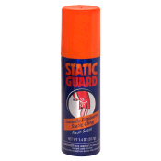
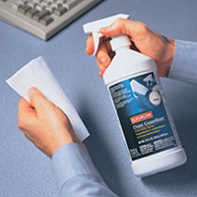
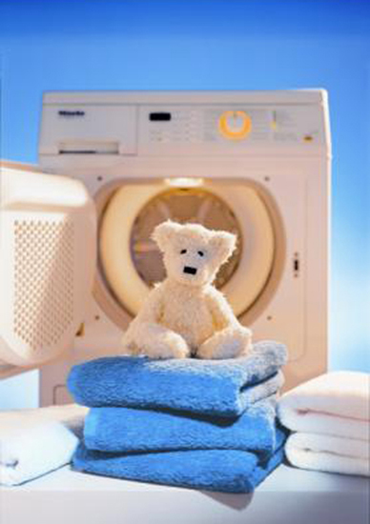
Higher
And there are also anti-static devices like:
Sprays, liquids and dusters made from conducting materials
which carry away electric charge preventing a build up of
charge that could be dangerous or a nuisance
‘Dryer sheets’ which contain oil, used in tumble dryers
and prevent the build up of static

Slide 12
Plenary
Put the following statements into the correct order to show how a person
could receive an electric shock whilst shopping.
A Touching the rail connects her to the earth.
B The carpet in the shop is nylon.
C The person receives a small electric shock.
D Friction leads to a build-up of charge on the person.
E When the person reaches the clothes rail she touches it.
F Walking on the carpet causes friction.
G Charges will travel from the person to the earth through the clothes rail.
Notes:
ANSWERS : B, F, D, E, G, A, C

Slide 13
Success Criteria
Grade E | Grade C | Grade A
Describe how you get an electric shock from charged objects | Explain how static electricity can be dangerous | Explain how the chance of receiving an electric shock can be reduced
Describe how you get an electric shock if you become charged and then earthed | Explain how static electricity can be a nuisance | Explain how the problems of static electricity can be reduced
Key Words:
atom • electron • charge • friction • induction • attract • repel • electrostatic

