Slide 1
P4: Radiation for Life
Lesson 3:
Uses of Electrostatics
(part 1)

Slide 2
Starter
ANSWERS
Static
Shock
Paddles
Charge
Defibrillator
Heart
Energy
Solve the following anagrams (all connected with charge and electrostatics):
cattis
chosk
desplad
garech
raid rifle bolt
rathe
regyne

Slide 3
Lesson Objectives
Understand the uses of electrostatics, particularly in dust precipitators

Slide 4
Success Criteria
Grade E | Grade C | Grade A
Recall that electrostatics is useful for electrostatic dust precipitators | Explain how static electricity can be useful for electrostatic dust precipitators | Explain how static electricity is used in electrostatic dust precipitators in terms of electron movement
Key Words:
negative • defibrillator • electrostatic • paddle • conductor • charge • dust precipitator

Slide 5
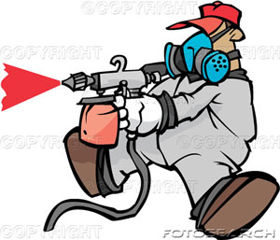
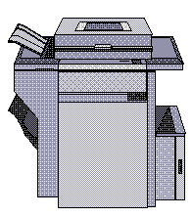
There are many uses of
static electricity:
A paint sprayer charges paint droplets to give an even coverage
Crop sprayers on farms work in the same way.
A photocopier and laser printer use charged particles to produce an image
Charged plates inside factory chimneys are used to remove dust particles from smoke
A defribrilator delivers a controlled electric shock through a patients chest to restart their heart

Slide 6
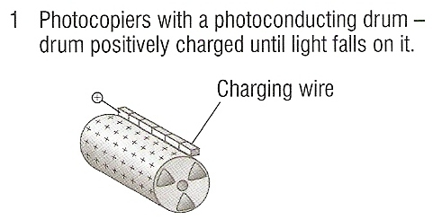
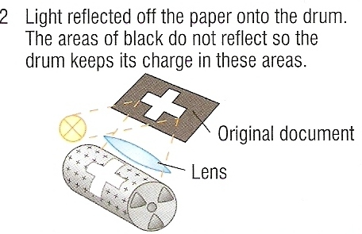
Uses of static electricity: 1. Photocopier

Slide 7
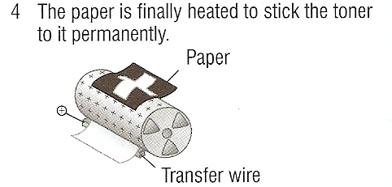

Slide 8
3. Paint spraying
The spray nozzle is connected is connected to the positive terminal of an electrostatic generator.
As the paint droplets leave they repel each other and spread out to form a fine cloud of paint.
The metal panel to be painted is connected to the negative terminal.
The negatively charged metal panel attracts the positively charged paint.

Slide 9
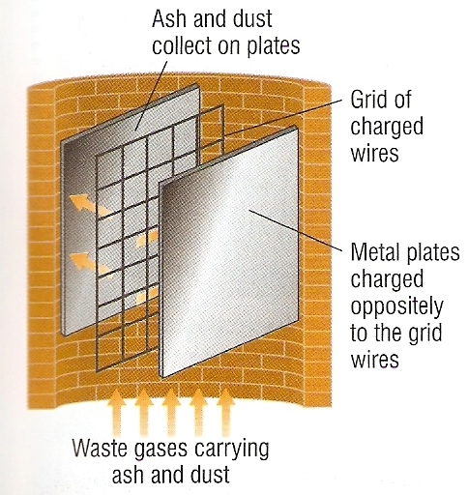
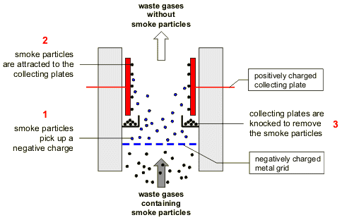
Electrostatic Dust Precipitators
Gases emitted from the chimneys of many factories and power
stations contain harmful particles that pollute the atmosphere.
A dust precipitator is used to remove these particles.
Metal plates and a grid/rods are put into the chimney
They are connected to a high-voltage supply so that the frid becomes negatively charged.
The plates are earthed and gain the opposite charge to the grid

Slide 10
Electrostatic Dust Precipitators
As the dust particles pass the grid/rods they become negatively charged
The dust particles are attracted to the plates because unlike charges attract
At intervals the plates are vibrated and the dust falls down to a collector

Slide 11
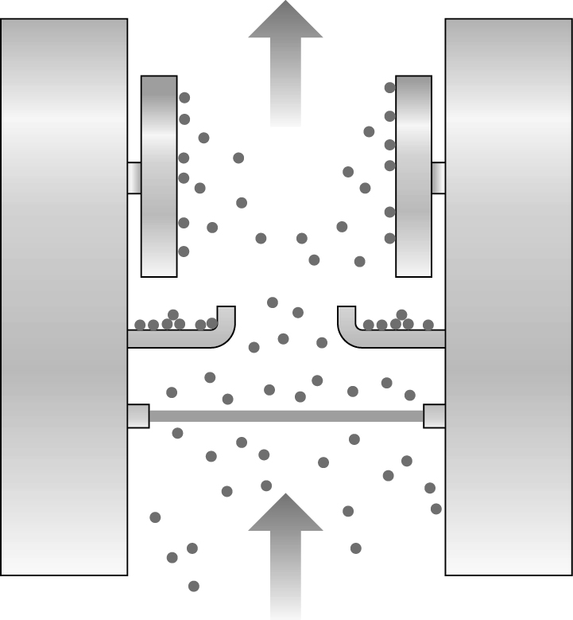
Can you make sense of it?
Put the following statements describing the dust precipitator into the correct order:
A At intervals the plates are vibrated and the dust falls down to a collector.
B As the dust particles pass the grid (or rods) they become negatively charged.
C They are connected to a high-voltage supply so that the grid becomes negatively charged.
D The dust particles are attracted to the plates because unlike charges attract.
E The plates are earthed and gain the opposite charge to the grid.
F Metal plates and a grid (or rods) are put into the chimney.
waste gases without smoke particles
earthed plates
smoke particles
charged grid
chimney
waste gases containing smoke particles
Notes:
Available as a worksheet - ANSWERS → F, C, E, B, D, A

Slide 12
Electrostatic Dust Precipitators
Higher
A dust precipitator inside a chimney contains wires in a grid that are given a large negative charge
As the dust particles pass close to the wires they gain electrons, becoming negatively charged.
The negative charge on the grid induces the opposite charge on the earthed metal plate
Opposite charges attract so the dust particles are attracted to the plate
They stick to the plate and are removed at intervals
The dust is used to make building blocks

Slide 13
Plenary
Match each use of static electricity with a brief description of how it works.
A. vehicles are covered with an even coat of charged paint.
Photocopier
B. small particles from smoke are collected by charged plates.
Defibrillator
C. an image is formed on paper by charging the ink drops.
Paint spraying
Dust precipitator
D. fields are covered with an even covering of fertiliser or insecticide.
Crop spraying
E. a human heart can be restarted by a controlled electric shock.

Slide 14
Success Criteria
Grade E | Grade C | Grade A
Recall that electrostatics is useful for electrostatic dust precipitators | Explain how static electricity can be useful for electrostatic dust precipitators | Explain how static electricity is used in electrostatic dust precipitators in terms of electron movement
Key Words:
negative • defibrillator • electrostatic • paddle • conductor • charge • dust precipitator

