Slide 1
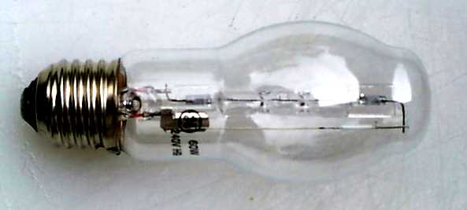
Calculating the resistance of a bulb
A filament bulb has a current of 5 A running through it, with a potential difference of 50 V across it.
What is the resistance of the filament in the bulb?
V = IR
R = V
I
= 50 V
5 A
= 10 Ω

Slide 2
P6 – Electricity for Gadgets
Lesson 3 – Resistors in series
Learning aim: Demonstrate an understanding of how resistors work in series circuits

Slide 3
Learning Objectives
Success Criteria
Understand how potential dividers work.
Understand how to add resistors in series.
Calculate the output from a potential divider.
Recall the properties of potential dividers. (Grade E-D)
Use R_{t} = R₁ + R₂ to find the total voltage of resistors in series. (Grade E-D)
Explain how combinations of fixed and variable resistors can be used in potential divider circuits. (Grade C)
Calculate V_{out} for simple ratios of resistors.(HT) (Grade C-A)
Explain how a V_{out} with adjustable threshold can be achieved. (Grade C-A)

Slide 4
Resistors in series
When resistors are connected in series, the total resistance can be calculated using:
Total resistance = R₁ + R₂
What is the total resistance for this circuit?
Total resistance
= R₁ + R₂
= 4 Ω + 2 Ω
4 Ω
2 Ω
= 6 Ω

Slide 5
Resistors in series
What is the total resistance for this circuit?
6 Ω
34 Ω
Total resistance = R₁ + R₂
= 6 Ω + 34 Ω
= 40 Ω

Slide 6
Copy the diagram and answer the questions
LD
Ammeter reads 2A
A
V
What is the resistance across this bulb?
Assuming all the bulbs are the same what is the total resistance in this circuit?
Voltmeter reads 10V

Slide 7
Experiment - P6b 01 (part a)
Using a variable resistor as a potential divider.
At the end of this experiment you should be able to produce a definition for a potential divider

Slide 8
Potential Dividers - Theory
Potential divider circuits allow us to obtain a required output voltage by ‘tapping off’ part of the input voltage
V_{IN}
R₁
V_{OUT}
R₂
0V
0V
The Potential Divider equation:
(R₂)
V_{OUT}
V_{IN} x
(R₁ + R₂)

Slide 9
V does not change
V = V₁ + V₂
The two resistors are dividing up the potential (or voltage) - (the Potential Divider)
R₁
V
V₁
R₂
V₂

Slide 10
What happens if:
V₁
V
V₂
R₁ increases and R₂ is unchanged?
V
R₁ decreases and R₂ remains the same?
V
The values of both R₁ and R₂ are doubled?
V₁
V
V₂
The values of both R₁ and R₂ are halved?
V₁
V
V₂
The supply voltage V is trebled?
x 3
x 3
3V

Slide 11
Uses of the potential divider
To supply a variable voltage
To make an input sensor from other components - many detectors will switch on as a voltage goes above or below a certain threshold (such as in a thermostat).

Slide 12
Practical P6b01(part b)
HT
I can design and construct a potential divider circuit to achieve a given output pd.
Equipment available: variety of resistors , leads, batteries, voltmeters.

Slide 13
Some example questions
HT
12V
50V
100 Ω
10 Ω
V_{OUT}
V_{OUT}
100 Ω
75 Ω
0V
0V
0V
0V
3V
1.5V
75 Ω
50 Ω
V_{OUT}
V_{OUT}
25 Ω
45 Ω
0V
0V
0V
0V

Slide 14
Answers
HT
A. 6V B. 44.12V
C. 0.75V D. 0.71V

Slide 15
To do
Complete the worksheet P6b01
Q2. Resistors in series
Then try – Q3a-c as well
Notes:
Q3 for HT
WS could be for plenary LD. Or draw a potential divider circuit on white boards

Slide 16
WS Answers
Q2a 6 V • Q2b 8 V • Q2c 6 V • Q2d 4 Ω and 12 Ω in series then take output from 4 Ω • Q3a 6 V • Q3b 1000 Ω • Q3c 4.5 V

Slide 17
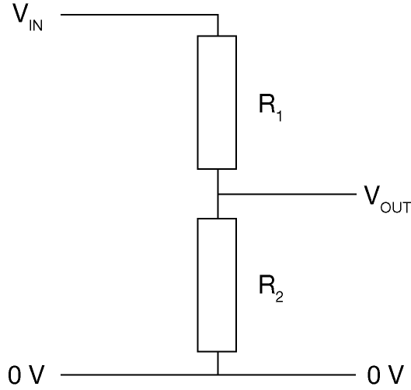
Plenary
HT
Copy and complete the table, for the circuit below.
V_{IN} (V) | R₁ (Ω) | R₂ (Ω) | V_{OUT} (V)
6 | 600 | 400
40 | 9000 | 15 000
 | 40 | 120 | 18
12 |  | 1000 | 3
Give two ways in which a variable output can be obtained without setting up a new circuit each time.
Notes:
LD draw a potential divider circuit on white boards that includes a variable resistor

Slide 18
Plenary answers
HT
Replace R₁ with a variable resistor; replace R₂ with a variable resistor
V_{IN} (V) | R₁ (Ω) | R₂ (Ω) | V_{OUT} (V)
6 | 600 | 400 | 2.4
40 | 9000 | 15 000 | 25.0
24 | 40 | 120 | 18.0
12 | 3000 | 1000 | 3.0

Slide 19
Learning Objectives
Success Criteria
Understand how potential dividers work.
Understand how to add resistors in series.
Calculate the output from a potential divider.
Recall the properties of potential dividers. (Grade E-D)
Use R_{t} = R₁ + R₂ to find the total voltage of resistors in series. (Grade E-D)
Explain how combinations of fixed and variable resistors can be used in potential divider circuits. (Grade C)
Calculate V_{out} for simple ratios of resistors.(HT) (Grade C-A)
Explain how a V_{out} with adjustable threshold can be achieved. (Grade C-A)

Slide 20
PC research task
http://www.bbc.co.uk/schools/gcsebitesize/science/triple_ocr_gateway/electricity_for_gadgets/sharing/revision/1/

