Slide 1
P4: Radiation for Life
Lesson 4:
Uses of Electrostatics
(part 2)

Slide 2
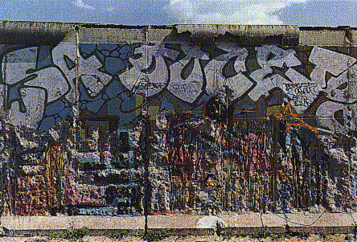
Starter
How many uses of electrostatics can you recall from last lesson
Look at the picture below, what do you think is the main topic of today’s lesson?

Slide 3
Lesson Objectives
Understand the use of electrostatics in:
Paint spraying
Defibrillator

Slide 4
Success Criteria
Grade E | Grade C | Grade A
Recall that electrostatics is useful for spraying paint and crops | Explain how static electricity can be useful for paint spraying | Explain how static electricity is used in paint spraying in terms of electron movement
Recall that electrostatics is useful for restarting the heart | Explain how electrostatics is useful for restarting the heart
Key Words:
negative • defibrillator • electrostatic • paddle • conductor • charge • dust precipitator

Slide 5
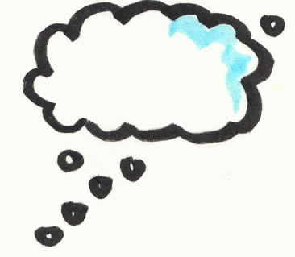
Paint spraying – how does this work?
The spray gun is charged
All the paint particles become charged with like charges
Like charges repel and the paint spreads out in a fine mist
The object to be sprayed is given the opposite charge
Opposite charges attract and so the paint is attracted to the object.
Think positively
..(and negatively?)
So what are the advantages?
Little waste of paint
Nice even coat of paint
Paint covers – even in the awkward places (‘shadows’)

Slide 6
More on Paint Spraying
Higher
If the object to be painted is not charges the paint
still moves on to it, but:
The object becomes charged from the paint, gaining more and more of the same charge
Further paint droplets are repelled away from the object
What can be done to overcome this?

Slide 7
More on Paint Spraying
Higher
Solution
This can be avoided by earthing the object to prevent a build up of charge.
Used mainly in factories and vehicle repair shops
The object is given the opposite charge to the paint.
Opposite charges attract so the paint is attracted to the car and gets into the ‘shadows’ giving good coverage.

Slide 8
What is Defibrillation?
Defibrillation is a procedure that restores a regular
heart rhythm by delivering an electric shock
through the chest wall to the heart.
Once the heart resumes its pumping action, blood
can once more flow throughout the body.

Slide 9
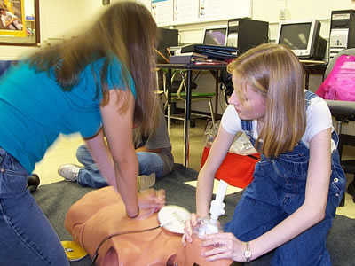
A defibrillator:
Two paddles are charged from a high-voltage supply
They are then placed firmly on the patient’s chest to ensure a good electrical contact
Electric charge is then passed through the patients to make their heart contract. Once the heart has been artificially restarted it is hoped that it will continue to contract normally
Great care is taken to ensure that the operator does not receive an electric shock

Slide 10
Calculation
A typical shock from a defribrillator supplies about 400J of energy in a few milliseconds. (1 millisecond = 0.001 seconds)
If a defribrillator is switched on for 5 milliseconds (5ms) calculate the power generated.
Use the formula:
Power (P) = Energy (E)
Time (T)
=
=
=
E
P
T

Slide 11
More on Defibrillators
What if you have a chronic heart condition and
want to be safe at home?
1. Portable defibrillators are small, portable machines that can be used in the home.
2. Implantable cardiac defibrillators are a small battery-operated device that can be surgically implanted under the skin, in the upper part of the chest wall, and connected to the heart.

Slide 12
Plenary
Complete the explanation below of how a bicycle frame is sprayed evenly all over
with paint without wasting any of the paint.
The spray gun is connected to the positive so that it becomes charged and the
frame is connected
____________________________________________
____________________________________________
____________________________________________
____________________________________________
____________________________________________
____________________________________________

Slide 13
Success Criteria
Grade E | Grade C | Grade A
Recall that electrostatics is useful for spraying paint and crops | Explain how static electricity can be useful for paint spraying | Explain how static electricity is used in paint spraying in terms of electron movement
Recall that electrostatics is useful for restarting the heart | Explain how electrostatics is useful for restarting the heart
Key Words:
negative • defibrillator • electrostatic • paddle • conductor • charge • dust precipitator

