Slide 1
P4: Radiation for Life
Lesson 5:
Safe Electricals (part 1)

Slide 3
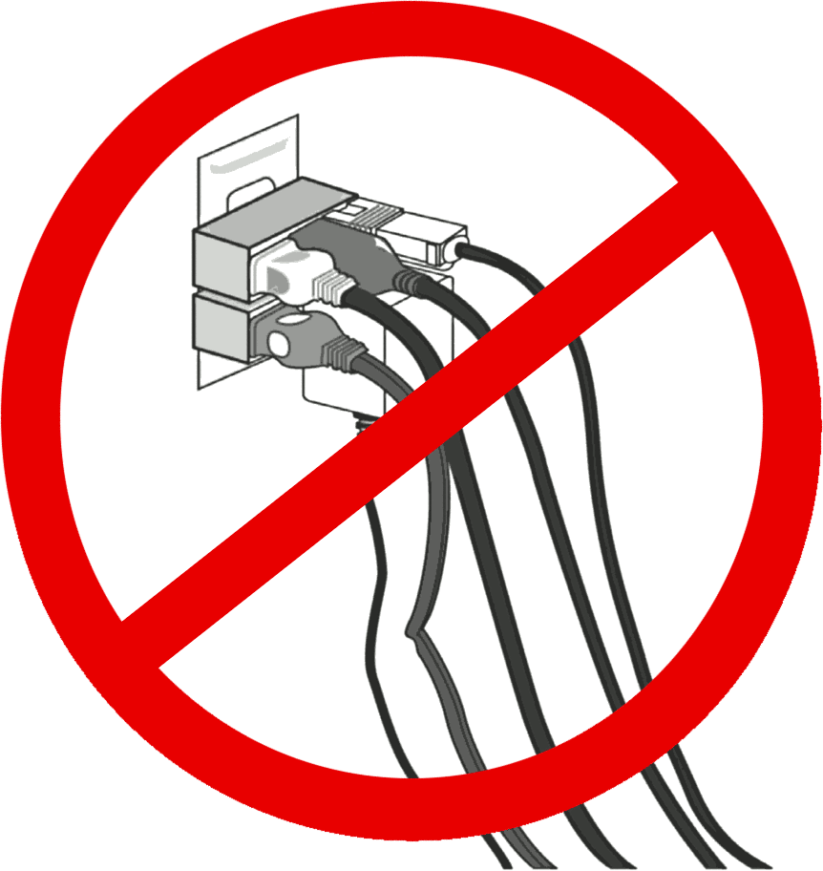

Slide 4
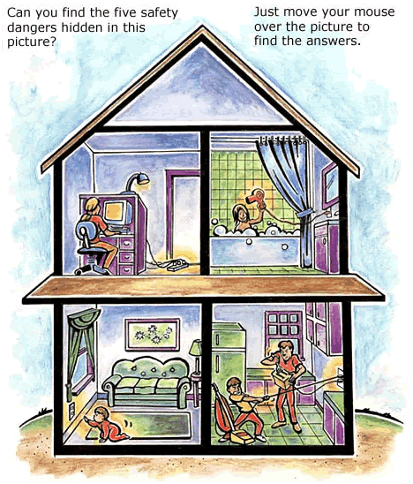

Slide 5
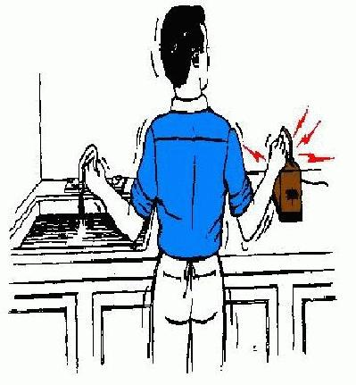
Starter
What do we remember about circuits?
What has the cartoon on the right
got to do with electrical circuits?
Don’t shout out the answer!

Slide 6
Lesson Objectives
Understand how resistors can be used to
change the current in a circuit.
Calculate resistance and understand the effect
of length and thickness on the resistance of a
wire.

Slide 7
Success Criteria
Grade E | Grade C | Grade A
Describe how resistors are used to change the current in a circuit | Explain how variable resistors are used to change current | Manipulate the equation: V = IR
 | Use the equation: R = V/I
Key Words:
resistor • current • resistance • ohms • potential difference • volt • conductor • circuit • voltmeter • ammeter

Slide 8
Electric Circuits
What is needed for any circuit to work?
A
R
A closed loop, with no gaps, is
Required for a circuit to work.
Charge cannot flow
across a gap in a circuit.

Slide 9
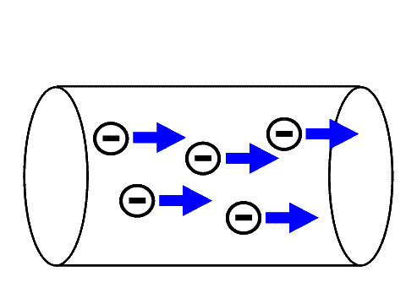
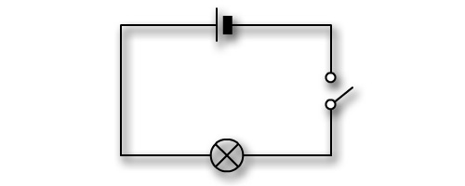
An electrical current is a flow of charge.
The charge is simply free-flowing electrons moving through wires/metal.

Slide 11
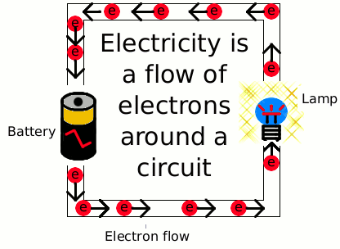

Slide 13
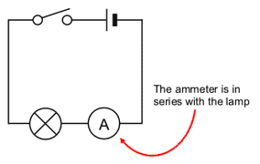
Measuring Current
It’s quite simple to measure the current in a circuit. An AMMETER
is placed in SERIES in the circuit.
The unit for current is the amp (A).
A

Slide 14
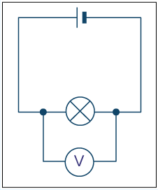
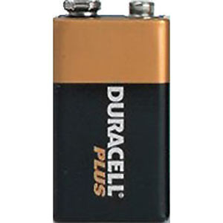
Potential difference/Voltage
The potential difference (pd) between two points in a circuit is the difference in voltage between the two points.
It is measured in volts (V) by a voltmeter which is placed in parallel in the circuit.
V

Slide 15
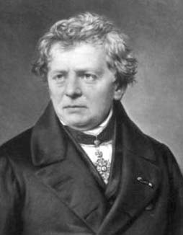
Resistance
Resistance is anything that will RESIST a current. It is measured in Ohms, a unit named after me.
Georg Simon Ohm 1789-1854
The resistance of a component can be calculated using Ohm’s Law:
V
Resistance = Voltage (in V)
(in Ω) Current (in A)
I
R

Slide 16
Rheostat
A rheostat (variable resistor) can be used to
change the resistance and current in a circuit.
The slider alters the length of wire in the circuit.
The longer the length of wire:
The bigger its resistance
The smaller the current
The dimmer the lamp
If thinner wire is used, it has a bigger resistance so
the current is smaller for the same length of wire.

Slide 17
It’s number crunching time!
Remember!
resistance =
voltage
current
Complete this table:
voltage in V | current in A | Resistance in Ω
12 | 4.0
3000 | 5.0
230 | 11.5
240 | 8.0
24 | 0.25

Slide 18
It’s number crunching time!
Higher
Remember!
Resistance is measured in ohms (Ω)
1 kΩ = 1000 Ω
1 MΩ = 1 000 000 Ω
1 mA = 0.001 A
Complete the following table.
resistance =
voltage
current
voltage (or potential difference) | current | resistance
12 V |  | 2.4 Ω
 | 0.5 mA | 47 kΩ
230 V |  | 23 Ω
 | 0.5 A | 2 kΩ
3 kV |  | 1.5 MΩ

Slide 19
Plenary
Write down 5 things you have learnt in today’s
lesson.
Share your list with your partner
Get ready to share with the class

Slide 20
Success Criteria
Grade E | Grade C | Grade A
Describe how resistors are used to change the current in a circuit | Explain how variable resistors are used to change current | Manipulate the equation: V = IR
 | Use the equation: R = V/I
Key Words:
resistor • current • resistance • ohms • potential difference • volt • conductor • circuit • voltmeter • ammeter

