Slide 1
Starter
Changes in technology are moving at a fast pace. Communication devices such as laptops, MP3 players, and mobile phones have become more and more common and have decreased in size and affordability.
List some advantages and disadvantages of these changes

Slide 2
P6 – Electricity for Gadgets
Lesson 5 – Transistors
Learning aim: Demonstrate an understanding of what transistors are and how they work.

Slide 3
Learning Objectives
Success Criteria
Recognise transistors in circuits.
Understand what transistors are.
Understand the impact of increasing access to new technologies.
Draw the symbol for a npn transistor, label the terminals. (Grade E-D)
Recall what the basic building block of an electronic component is.
(Grade E-D)
Describe benefits and drawbacks of miniature circuits. (Grade C)
Use the equation I_{e} = I_{b} + I_{c}. (Grade C)
Understand how current flows through a transistor.(Grade D-A)
Complete a labelled diagram showing how a transistor can be used as an electronic switch for an LED.
(Grade C-A)
Explain how increasing availability of computers requires society to make choices about acceptable use of new technologies.(Grade C-A)

Slide 4
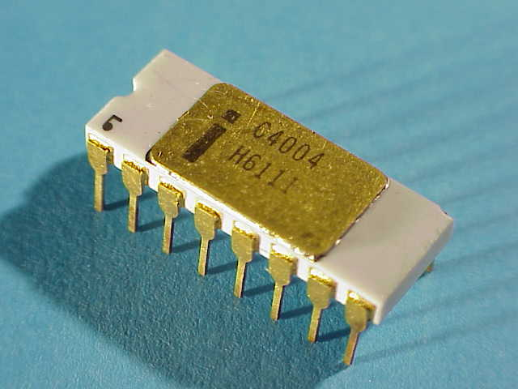
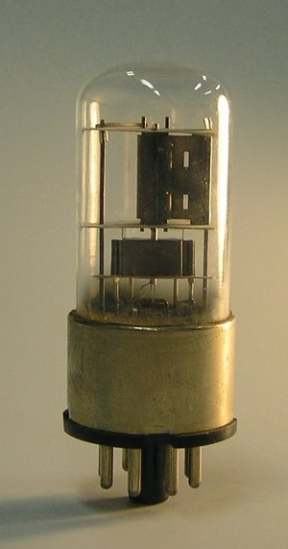
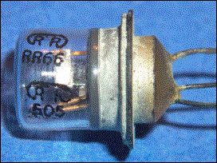
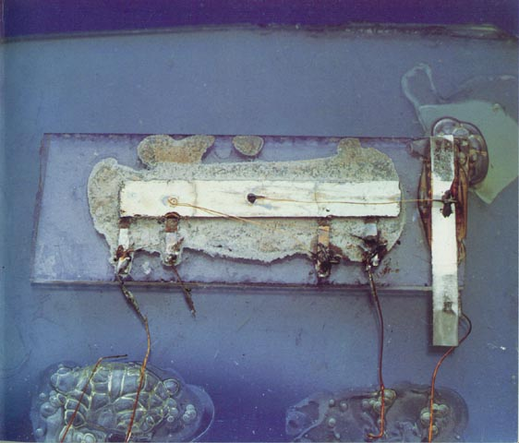
Logic in Hardware
1971 Ted Hoff
Microprocessor
1947 Bardeen and Brattain
Transistor
1906 Lee de Forrest
The Valve
1958 Jack Kilby
Integrated Circuit

Slide 5
Pros and cons
Of miniature circuits?
Discuss in pairs
Then share in groups

Slide 6
What is a transistor?
Read pg 238
Draw the symbol for a transistor
Label the terminals
Have a go atquestions 1&2

Slide 7
Transistors
A transistor acts like a switch:
When a SMALL current flows through the base-emitter part of the transistor a different current is switched on through the collector-emitter part.
Collector
Base
Emitter

Slide 8
Transistor facts
Transistors are the building blocks for modern electronic circuits
Transistors work with a very low current
They behave like a switch
They can be connected together to make logic gates

Slide 9
Transistors fact sheet
Read the fact sheet and pages 238-9.
Complete questions 1-4
Do the ‘To Do’ section of the factsheet

Slide 10
Use the equation I_{e} = I_{b} + I_{c}.
I = Current
Remember current is like water flowing through a pipe
-what goes in must come out
Use the above equation to answer Q3 pg 239

Slide 11
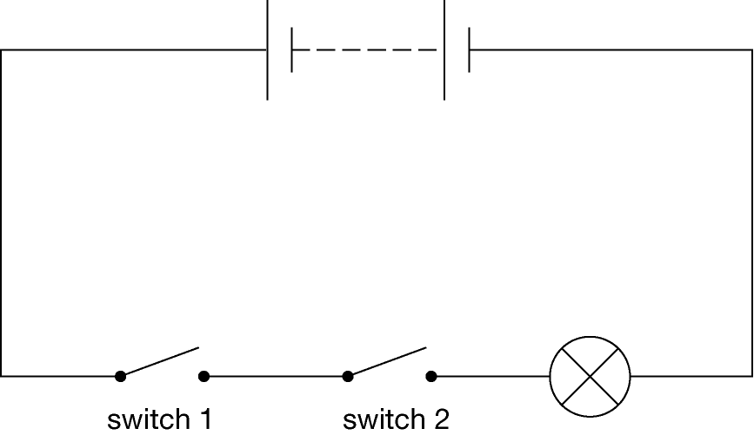
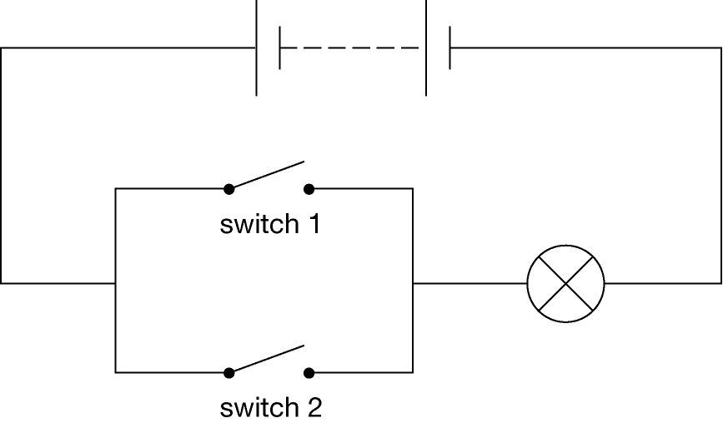
In pairs explain what needs to happen to get the lamp to light.

Slide 12
Logic gates
NOT gate – “the output is NOT what the input is”
Logic gates are the basics behind any kind of processor. There are 3 that you need to know for GCSE:
Input | Output
0 | 1
1 | 0
Input A | Input B | Output
0 | 0 | 0
0 | 1 | 0
1 | 0 | 0
1 | 1 | 1
AND – “the output is on if A AND B are both on”
Input A | Input B | Output
0 | 0 | 0
0 | 1 | 1
1 | 0 | 1
1 | 1 | 1
OR – “the output is on if A OR B are on”

Slide 13
Logic gate symbols
NOT gate:
AND gate:
OR gate:

Slide 14
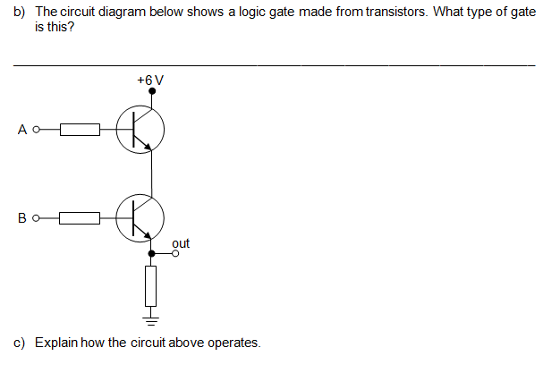
Plenary

Slide 15
Learning Objectives
Success Criteria
Recognise transistors in circuits.
Understand what transistors are.
Understand the impact of increasing access to new technologies.
Draw the symbol for a npn transistor, label the terminals. (Grade E-D)
Recall what the basic building block of an electronic component is.
(Grade E-D)
Describe benefits and drawbacks of miniature circuits. (Grade C)
Use the equation I_{e} = I_{b} + I_{c}. (Grade C)
Understand how current flows through a transistor.(Grade D-A)
Complete a labelled diagram showing how a transistor can be used as an electronic switch for an LED.
(Grade C-A)
Explain how increasing availability of computers requires society to make choices about acceptable use of new technologies.(Grade C-A)

Slide 16
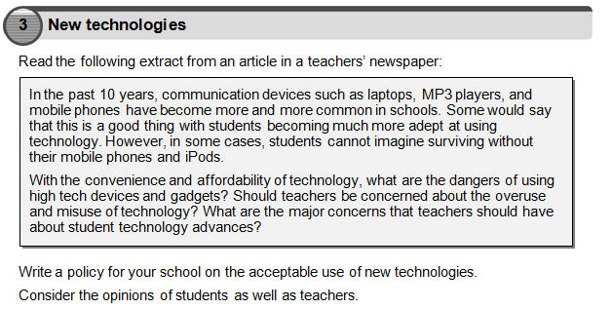
HT

