Slide 1
P4: Radiation for Life
Lesson 6:
Safe Electricals (part 2)

Slide 2
Starter
Last lesson we learnt an equation for calculating
resistance from the current and the voltage.
Write the equation you learnt
Complete the magic triangle below using V, I and R

Slide 3
Lesson Objectives
Recognise the colour coding in a three-pin plug and describe the functions of the live neutral and earth wires.
Explain how fuses, earth wires and circuit breakers work and understand the term ‘double insulated’.
Use the equation for electrical power to choose the correct fuse for an appliance.

Slide 4
Success Criteria
Grade E | Grade C | Grade A
Recall the colour code for live, neutral and earth wires | Describe the functions of the live, neutral and earth wires
Describe reasons for the use of fuses and circuit breakers | Explain how a wire fuse reduces the risk of fire if a fault occurs | Explain reasons for the use of fuses and circuit breakers
Recognise that ‘double insulated’ appliances do not need earthing | Use the equation: P = IV | Manipulate the equation: P = IV to select a fuse
 | Explain why ‘double insulated’ appliances do not need earthing
Key Words:
live • neutral • earth • power • fuse • circuit breaker • double insulated

Slide 5
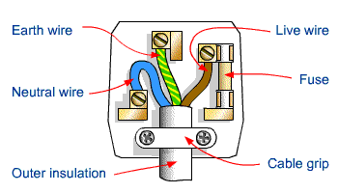
Starter
Plugs, and many other electrical appliances are now ‘double insulated’. What does this mean?
So what are the safety features of the three-pin plug that you can see in this sketch?
1.
Earth wire
4.
Live wire
5.
Fuse
2.
Neutral wire
6.
Cable grip
3.
Insulation

Slide 6
Why 3 wires?
Brown = Live Wire
Blue = Neutral Terminal
Green/Yellow = Earth
this carries a high voltage into and around the house
this completes the circuit providing a return path for the current to the local electricity sub-station, where it is earthed.
This is a safety wire. It is connected to the metal case of an appliance to prevent it becoming charged if touched by a live wire. It provides a low resistance path to the ground.

Slide 7
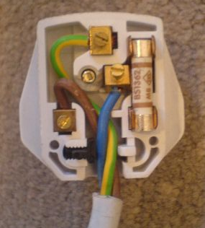
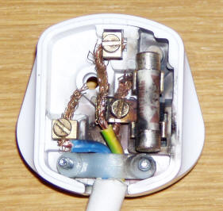
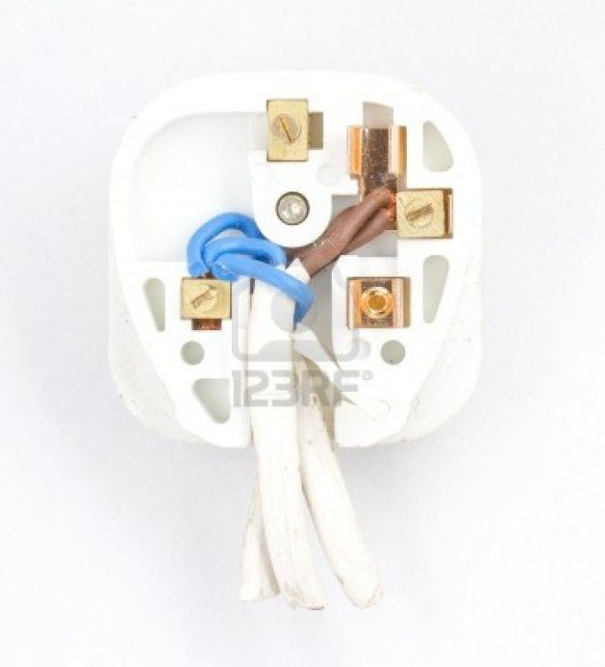
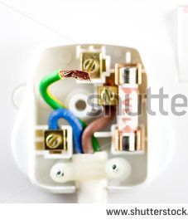
What’s wrong with these plugs?

Slide 8
Why is a plug earthed
If it is earthed, it is connected to the ground.
This means that any charge in it flows safely
down to the ground and a person touching it
does not get an electric shock.
It cannot become live!
Earth (or ‘ground’)

Slide 9
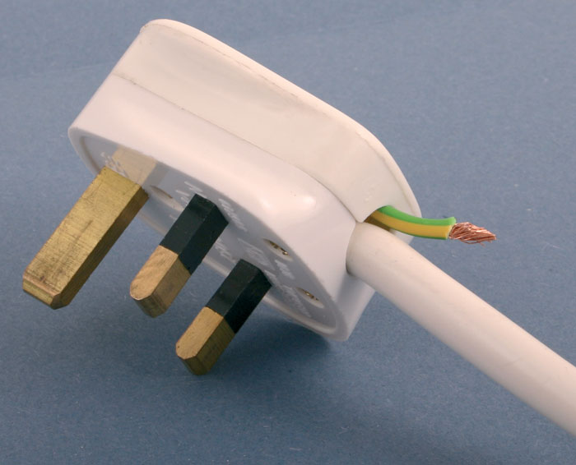
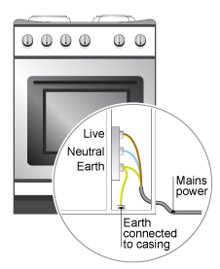
Why is this NOT a good idea??

Slide 10
What about the other terms?
Double-insulation
Double insulated appliances
do not need earthing. They have a
plastic case with no electrical connections
to it so the case cannot become live.
Fuses are always included in mains electricity circuits and plugs. Fuses stop the electric current if a fault occurs. They prevent wires and equipment overheating and possibly catching fire. A wire fuse has to be replaced when the fault has been corrected.
Fuse

Slide 11
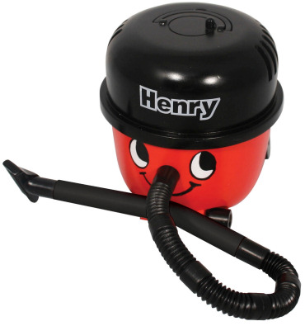
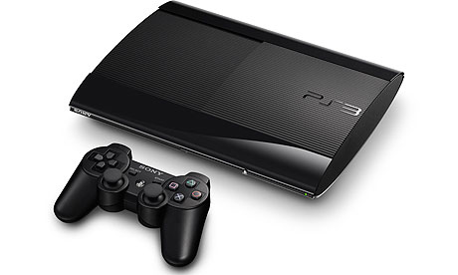
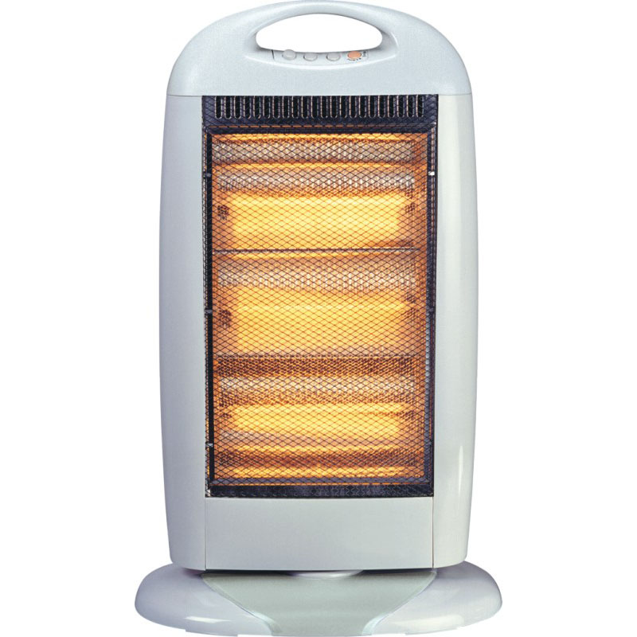
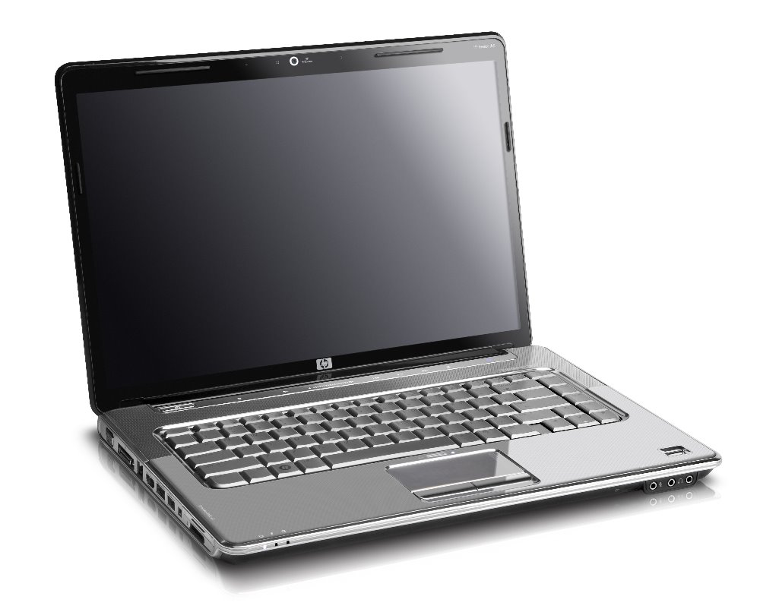

Slide 12
More on Fuses
If an appliance develops a fault:
Once the fuse melts, the appliance is now disconnected from the mains supply... It no longer works or allows charge to flow through it.
The fuse will need to be changed.
For some reason, there is suddenly a large current in the live and earth wires.
This prevents fires and further damage to the appliance from occurring.
The fuse melts due to this because the current becomes too large, stopping the flow of charge.
3
5
1
4
2

Slide 13
What would make a fuse better?
Higher
The easiest way would be to have a resettable fuse.
These exists and are known as ‘circuit-breakers’
These have replaced wire fuses in fuse boxes.
Advantages:
A wire does not need to be replaced to restore power
A circuit-breaker can be reset at the flick of a switch.

Slide 14
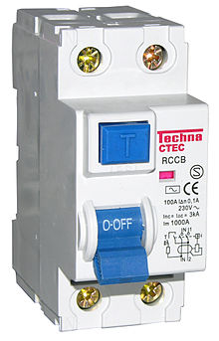
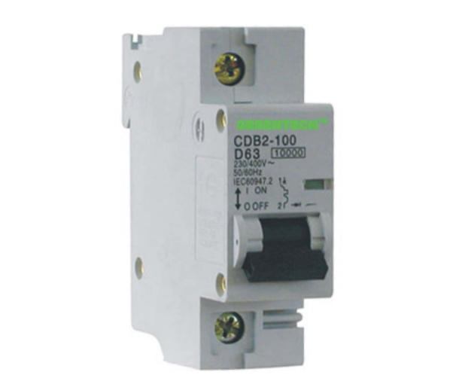
Alternatives to Fuses
Circuit Breakers
Circuit breakers are like ‘resettable’ fuses.
As soon as the current overloads, the switch trips and the current stops flowing.
Rather than replacing a fuse, a circuit breaker is just ‘tripped’ back in to the original position.
Residual Current Device
An RCD works like a circuit breaker, but also prevents against electrocution.
It is sensitive to about 10 milliseconds, which means that charge cannot flow into a person quick enough to electrocute them.

Slide 15
POWER!
What is power?
Power is the rate at which an appliance transfers
energy.
Power = Current x Voltage
P = I x V
Higher
Put this equation into a magic triangle

Slide 16
Practice makes Perfect!
QUESTION
A vacuum cleaner working from 230V main
supply has a current of 7A.
1. What is its power rating?
2. Should you fit a 5A or 13A fuse?

Slide 17
Calculating the Fuse Rating
Higher
With your magic triangle, make current the
Subject.... What do you get?
Current = Power
Voltage
Notes:
Power = 230 x 7 = 1610W

Slide 18
Plenary Worksheet
Foundation
What fuse should be fitted in the plug connected to the following appliances?
(3 A, 5 A, 10 A and 13 A fuses are available.)

Slide 19
Plenary
Higher
1. A 230V kettle has a power rating of 2500W.
Calculate the current used
Would you need a 3A, 5A, 10A or 13A fuse?
2. Sara’s 230V iron has a power rating of 1900W.
Calculate the current when working normally
Would you need a 5A or 13A fuse?

Slide 20
Success Criteria
Grade E | Grade C | Grade A
Recall the colour code for live, neutral and earth wires | Describe the functions of the live, neutral and earth wires
Describe reasons for the use of fuses and circuit breakers | Explain how a wire fuse reduces the risk of fire if a fault occurs | Explain reasons for the use of fuses and circuit breakers
Recognise that ‘double insulated’ appliances do not need earthing | Use the equation: P = IV | Manipulate the equation: P = IV to select a fuse
 | Explain why ‘double insulated’ appliances do not need earthing
Key Words:
live • neutral • earth • power • fuse • circuit breaker • double insulated

