Slide 1
Lesson 7 The Specific Immune Response
OCR AS Biology – F212 – Module 2
Food & Health

Slide 2
Learning Objectives
Success Criteria
Understand the role of the specific immune system.
Understand the role of B and T Lymphocytes in fighting off pathogens.
State the role of antigen (E-D)
Describe how B & T lymphocytes detect antigens (D-C)
Describe the processes of clonal selection and expansion (C-B)
Explain how differentiated B & T lymphocytes fight off pathogens (B-A)

Slide 3
Starter Question
Write down 5 things you know about the immune system…

Slide 4
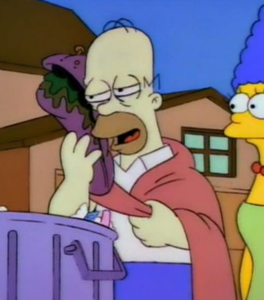
An Intro to the Immune Response
Unfortunately, the primary lines of defence discussed last lesson can sometimes be breached.
If this happens, we usually fall ill.
It is now time for a much more targeted response to fight the pathogen.
This involves lots of specialised cells and chemicals…
The SPECIFIC IMMUNE RESPONSE.

Slide 5
Some Key Words We’ll Come Across…
Antigens
Antibodies
Cytokine
Immunity
Interferon
Lymphocyte (B & T)
Lysosome
Macrophage
Memory Cells
Phagocyte
Plasma Cells
Receptor
How many of these do you already know the definition of?

Slide 6
The Immune Response
Sooner or later, pathogens will enter our body…
This kick starts the immune response.
It is specfic to the invading pathogen.
Body
Pathogen!
Pathogen!
Primary/Secondary Defences
Pathogen!

Slide 7
The Immune Response – In Detail

Slide 8
Detection of the Pathogen
Pathogens have antigens on their surface.
The antigens trigger the specific immune response.
Antigens have a specific shape.
They are usually a protein or glycoprotein.
Bacterial cell with antigens on its surface
Antigens on a pathogen are recognised as foreign.
The cells in the body responsible for detecting the antigens on the pathogens are:
&
B Lymphocytes
T Lymphocytes

Slide 9
B Lymphocytes & T Lymphocytes
B & T lymphocytes patrol the body for foreign antigens.
They have receptors in their membranes that are complementary to foreign antigens.
B
The B & T lymphocytes with the correct receptors must bind to the antigens for the immune response to start.
There are only a few of the correct B & T cells.
How can the B & T lymphocytes with correct receptors be helped in finding the antigens?
receptors
T

Slide 10
Presentation of the Antigens
There are 2 major ways in which the antigens can be presented to the B & T lymphocytes.
1. Infected cells display antigens on their surface
2. Macrophages also display antigens on their surface
Normal body cells infected with the pathogen will try to destroy it with lysosomes.
They then present the antigens on their surface as a distress signal.
When a macrophage phagocytoses a pathogen, it presents the antigens on its surface.
It acts as an ANTIGEN-PRESENTING CELL.
Infected body cell
Antigen being presented
Antigen being presented
Macrophage

Slide 11
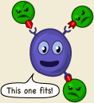
Clonal Selection
Clonal Expansion
Followed
by...

Slide 12
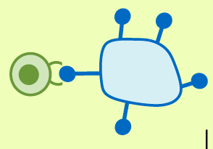
Clonal Selection & Expansion
Eventually, B & T lymphocytes with complementary receptors will detect the foreign antigen.
This is called CLONAL SELECTION.
Before the selected B and T lymphocytes can effectively fight the pathogen, they must increase in number.
They do this my mitosis, and this is called CLONAL EXPANSION.
Found you!
Pathogen
B or T Lymphocyte
Antigen

Slide 13
Differentiation of B & T Lymphocytes
Now, it is time for the B & T cells to differentiate (specialise).
The cells above play many roles in fighting off the pathogen.
The next couple of slides explain what their roles are.
T Lymphocytes
B Lymphocytes
T-helper
cells
T-killer cells
T-memory
cells
Plasma Cells
B-memory Cells

Slide 14
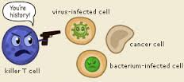
What do T Lymphocytes differentiate into?
T-killer Cells
Their job is quite simple:
Find and kill cells infected with
the pathogen.
T-memory Cells
These cells remain in the blood for a very long time.
They carry receptors for the pathogen and speed up
The immune response if the body is infected by the
Same pathogen again.
Later that year...
T-helper Cells
These cells are messengers, and they
stimulate B cells to develop
More detail...

Slide 15
T-helper cells release chemicals called cytokines which stimulate the differentiation of B lymphocytes...
= Cytokine
Plasma Cells
T-helper release cytokines
A clonally selected B-lymphocyte
B-memory Cells

Slide 16
What do B Lymphocytes differentiate into?
Plasma Cells
These cells flow around the blood and manufacture and release antibodies.
Antibodies are proteins specific to the antigen of a pathogen.
Looked at in detail in the next lesson...
B-memory Cells
These are similar to T-memory cells.
If the same pathogen invades the
body again, B-memory cells will
rapidly produce antibodies to
fight the infection.

Slide 17
This all takes time...

Slide 18
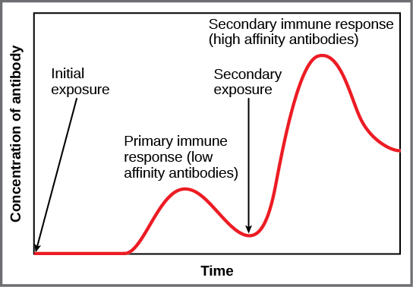
This all takes time...
Remember that the correct lymphocytes must be selected.
Then they must divide.
Then they much differentiate.
Then some cells must manufacture antibodies.
All of this means that it’s a few days before the number of antibodies in the blood starts to rise.
But, the immune response leaves memory cells in the blood.
If a second invasion occurs by the same pathogen, rapid production of plasma cells occurs, which releases antibodies quickly.

Slide 19
Plenary Questions
Explain why the immune system does not attack our own body cells.
What is the difference between T-helper and T-killer cells?
What is the role of the T & B memory cells?

Slide 20
Learning Objectives
Success Criteria
Understand the role of the specific immune system.
Understand the role of B and T Lymphocytes in fighting off pathogens.
State the role of antigen (E-D)
Describe how B & T lymphocytes detect antigens (D-C)
Describe the processes of clonal selection and expansion (C-B)
Explain how differentiated B & T lymphocytes fight off pathogens (B-A)

