Slide 1
Starter
Can you work out today’s topic from Bat Fink’s
clue?
PHEW! I’d be lost without my echo location.
Looking at that brick wall, it’s lucky I got it checked out... otherwise, I, Bat Fink, would have become a finkment of your imagination!

Slide 2
P4: Radiation for Life
Lesson 7:
Ultrasound (part 1)

Slide 3
Lesson Objectives
Understand that ultrasound is a longitudinal wave with a very high frequency.

Slide 4
Success Criteria
Grade E | Grade C | Grade A
Recall that ultrasound is a longitudinal wave | Describe features of longitudinal waves | Compare the motion of particles in longitudinal and transverse physical waves
Recognise wavelength, compression and rarefaction | Recall that the frequency of ultrasound is above the upper threshold of human hearing
Key Words:
ultrasound • frequency • longitudinal • transverse • rarefaction • compression • wavelength • hertz • vibrate

Slide 5
If you guessed the starter right, it’s treat time.... Push the button
If you guessed the starter wrong.... It’s time for your forfeit ;-)
Who is brave enough to push the button?

Slide 6
All together now for a Mexican Wave….

Slide 7
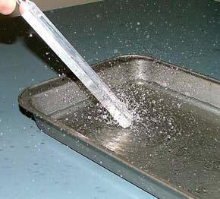
So what causes this?
Shall we try it out?
What then is the fundamental difference between the ‘mexican wave’ wave, and the ‘tuning fork’ wave?

Slide 8
You will now see demonstrated, the use of a ‘slinky’ and a long narrow spring to illustrate some of the features of a transverse wave and a longitudinal wave.

Slide 9
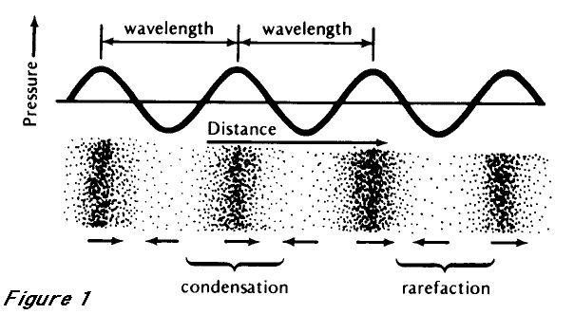
Longitudinal waveform
compression

Slide 10
Some definitions…
Higher
Transverse waves are when the displacement is at right angles to the direction of the wave…
Longitudinal waves are when the displacement is parallel to the direction of the wave…

Slide 11
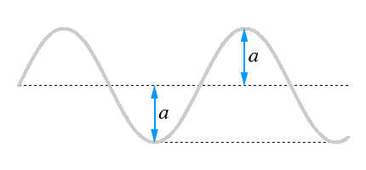
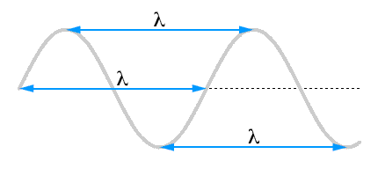
Remember these definitions?…
Higher
1) Amplitude – this is “how high” the wave is:
What is the equivalent for a longitudinal wave?
2) Wavelength (λ) – this is the distance between two corresponding points on the wave and is measured in metres:
What is the equivalent for a longitudinal wave?
3) Frequency – this is how many waves pass by every second and is measured in Hertz (Hz)

Slide 12
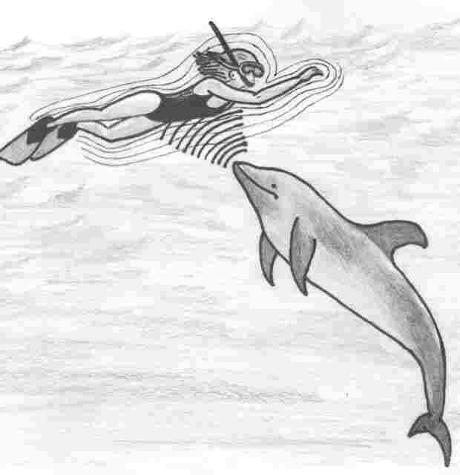
Ultrasound
So what have these images have in common?

Slide 13
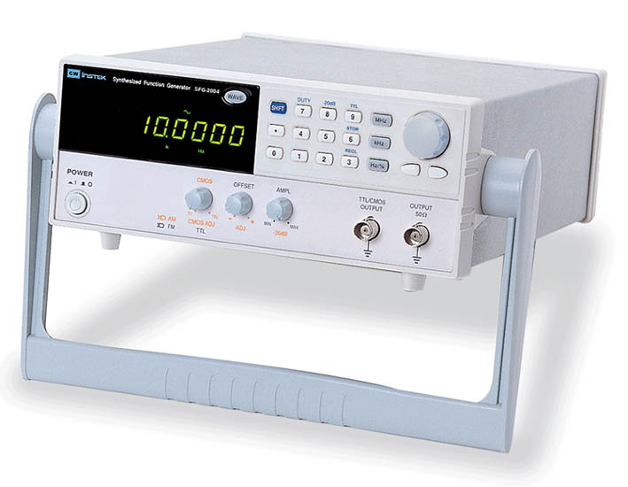
Ultrasound is longitudinal vibrations occurring at greater than 20kHz (20,000 vibrations per second!)
Now let’s look at our own ‘threshold of hearing’!

Slide 14
In a nutshell!
Ultrasound is sound of a high frequency than humans can hear!
Ultrasound has a frequency greater than 20,000Hz (20kHz)
Ultrasound is a longitudinal wave. It travels as a pressure wave that is a series of compressions and rarefactions.
At the centre of a compression the pressure is greater. Why?
At the centre of the rarefaction the pressure is smaller than when no wave is present. Why?
A pressure wave can only exist in a medium.
The denser the medium, the faster a wave travels.
Particles closer together
Particles further apart
If a wave was to travel through steel, air and water... Which medium would the wave travel quickest in and which would it travel slowest in?

Slide 15
Plenary
TRUE OR FALSE!
(5 questions)
Ultrasound is a transverse wave
A compression is a place of high pressure
Ultrasound is a region in the electromagnetic spectrum
If the frequency of a wave doubles, then its wavelength doubles too
Ultrasound cannot travel in a vacuum
Higher
Justify your answer. E.g. Explain why it’s true/false

Slide 16
Higher
Plenary
What would you notice if you increased the amplitude of a light wave
The frequency of a wave is 330Hz. How many times does it vibrate in 1 second?
What evidence could you give that light travels faster than sound?
Ultrasound is sound vibrating under 20,000 Hz. - True or False?

Slide 17
Success Criteria
Grade E | Grade C | Grade A
Recall that ultrasound is a longitudinal wave | Describe features of longitudinal waves | Compare the motion of particles in longitudinal and transverse physical waves
Recognise wavelength, compression and rarefaction | Recall that the frequency of ultrasound is above the upper threshold of human hearing
Key Words:
ultrasound • frequency • longitudinal • transverse • rarefaction • compression • wavelength • hertz • vibrate

