Slide 1
Starter
Like last lesson, can you guess today’s topic from
the hint below? Today’s hint is key words...
scan • X-ray • vibrations • image • reflect • pulse • longitudinal • frequency • diagnosis • therapy

Slide 2
P4: Radiation for Life
Lesson 8:
Ultrasound (part 2)

Slide 3
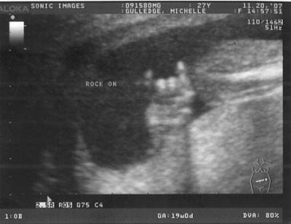
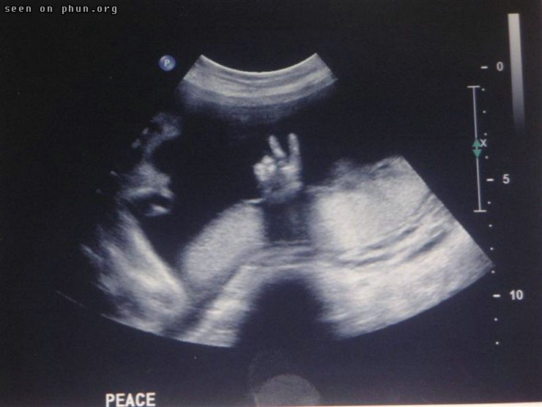
Guessed It?
The two coolest unborn babies ever... For now!

Slide 4
Lesson Objectives
Recognise the use of ultrasound in medicine for diagnosis.
Explain how ultrasound can be used to break down, e.g. kidney stones.
Understand why ultrasound is preferable to X-rays for certain scans.

Slide 5
Success Criteria
Grade E | Grade C | Grade A
Recognise that ultrasound can be used in medicine for diagnosis | Recognise that ultrasound can be used in medicine for therapy | Explain how ultrasound is used in medicine
 |  | Explain why ultrasound is used instead of X-rays for some scans
Key Words:
scan • ultrasound • X-ray • vibrations • image • reflect • pulse • longitudinal • frequency • diagnosis • therapy

Slide 6
Ultrasound in Medicine
Ultrasound is used in medicine to:
Check the condition of a foetus
Investigate heart and liver problems
Look for tumours in the body
Break down kidney stones and stones elsewhere in the body
Measure the speed of blood flow in blood vessels when a blockage of a vein or artery is suspected
Removing cataracts from the cornea of the eye

Slide 7
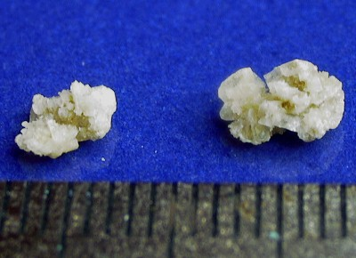
Kidney Stones
A high powered ultrasound beam is used to break down stones in the kidney/elsewhere.
Even large stones can be broken down into
smaller fragments to make it easier to excrete
from the body... OUCH!
Before this method, stones required major surgery.

Slide 8
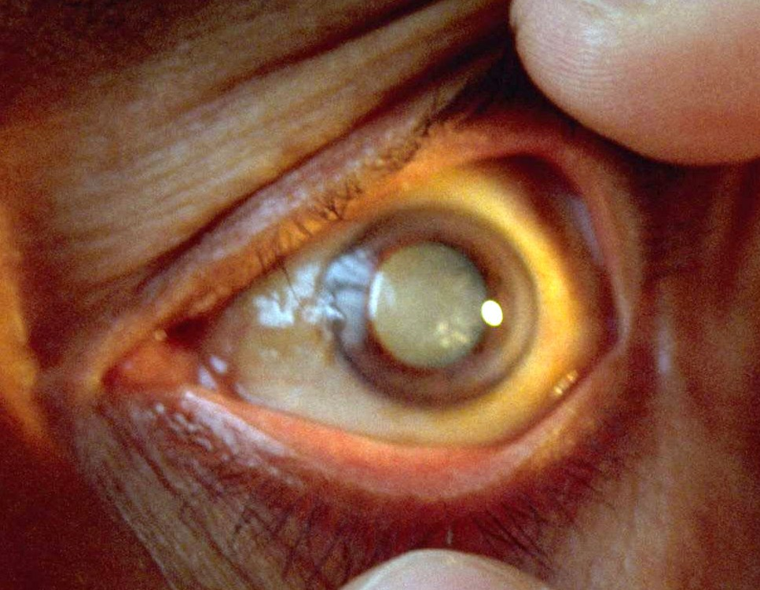
Cataracts
Cataracts is when you lose the transparency in
the lens of your eye.
A surgeon uses ultrasound to break up the
opaque lens of a patient.
The defective lens is surgically removed and
replaced by an artificial one.

Slide 9
So how does ultrasound work for imaging?
Higher
Ultrasonic waves are partly _________ at the boundary as they pass from one _______ to another. The time taken for these reflections can be used to measure the _______ of the reflecting surface and this information is used to build up a __________ of the object.
A gel is used to make a good contact. If this was not used nearly all of the ultrasound would be reflected at the skin surface.
Words – depth, reflected, picture, medium

Slide 10
Higher
….and remember that we can actually measure distance using sound, if we know the speed at which the sound travels and the time it takes to rebound from a hard surface!
Remember too that:
The unit of distance is:
The metre (m)
The unit of time is:
The second (s)
metres per second
(m/s or ms⁻¹⁾
The unit of speed is:
D
And that
Speed = distance (in metres)
time (in seconds)
S
T

Slide 11
Higher
The speed of ultrasound in soft tissue is 1500 m/s. The time delay for an echo from ultrasound in soft tissue was 0.0002 s.
At what depth was it reflected?
Distance = speed x time
= 1500 x .0002
= 0.3m
BUT, the wave had to go there and back, so actual distance travelled was TWICE as far as the depth.
ANSWER, therefore = 0.3 / 2 meters = 0.15 m.

Slide 12
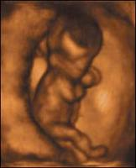
Factors to Consider
Higher
The proportion of ultrasound reflected depends
upon:
The densities of the adjoining tissues
The speed of sound in the adjoining tissues
3-D computer assisted scans are now used in
foetal scanning

Slide 13
Cooler Still...
Higher
Doppler Ultrasound Scanner
If ultrasound waves hit a moving object the frequency of the
echoes alters. This allows us to detect movement and measure
speed of blood flow or foetal heart rate.
Why not X-rays?
Ultrasound can differentiate between soft tissues better... But X-
rays show bones better.
Ultrasound does not damage living cells... Whilst X-rays can kill
cells or bring about changes in them that can lead to cancers.

Slide 14
Plenary
6 cm
1. Look at the diagram of a slinky below:
i. Label the compressions and rarefactions on the wave.
ii. What is the wavelength of this wave?
iii. Name an animal that makes use of ultrasound.
2. What do we use ultrasound in medicine for?
3. List 3 uses of ultrasound in medicine.
HIGHER
4. Explain how ultrasound is used in medicine for treatment
5. Suggest why a pregnant woman is scanned using ultrasound but is never X-rayed.

Slide 15
Success Criteria
Grade E | Grade C | Grade A
Recognise that ultrasound can be used in medicine for diagnosis | Recognise that ultrasound can be used in medicine for therapy | Explain how ultrasound is used in medicine
 |  | Explain why ultrasound is used instead of X-rays for some scans
Key Words:
scan • ultrasound • X-ray • vibrations • image • reflect • pulse • longitudinal • frequency • diagnosis • therapy

