Slide 1
P4: Radiation for Life
Lesson 9:
What is Radioactivity
(part 1)

Slide 2
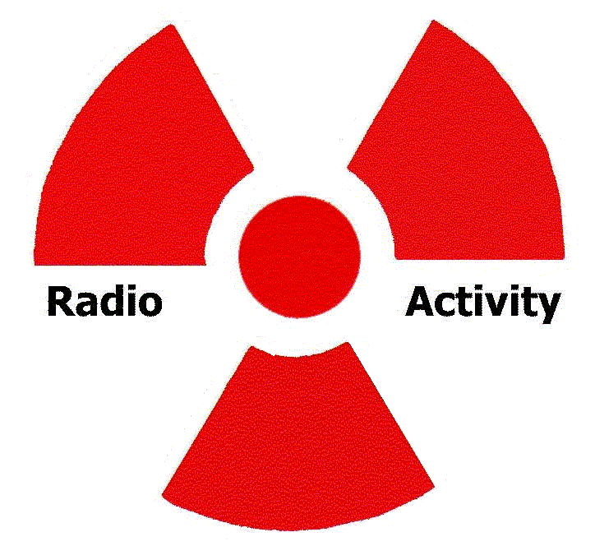
Starter
What words come to mind when you think of: RADIOACTIVITY
Make a list of these words in the back of your book.

Slide 3
Lesson Objectives
Recognise that nuclear decay occurs naturally.
Describe how the activity of a sample is measured.
Understand the term ‘half-life’.

Slide 4
Success Criteria
Grade E | Grade C | Grade A
Recognise how the radioactivity of an object is measured | Recall and describe the relative nature of radioactive decay | Interpret graphical data of radioactive decay and calculate half-life
Understand that radioactivity decreases with time | Explain and use the concept of half-life
Key Words:
alpha • beta • gamma • ionising • decay • half-life • activity • becquerels • GM tube

Slide 5
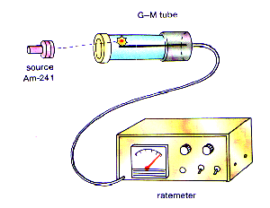
A ‘geiger counter’ is used to detect the rate of decay of a radioactive substance.
The activity is measured by counting the number of nuclei that decay in one second. (Also called count rate)
Activity is measured in becquerels (Bq)
Activity = number of nuclei that decay
time taken in seconds
The activity of a radioactive substance decreases with time. This is shown by the count rate falling.

Slide 6
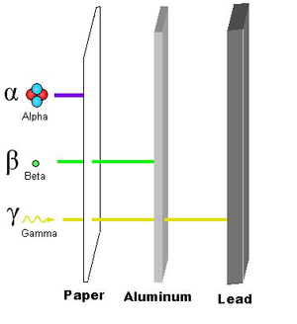
What causes the Geiger-Counter to ‘click’?

Slide 7
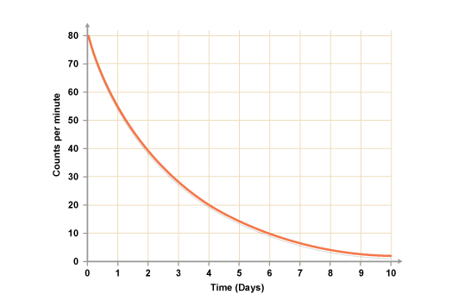

Slide 8
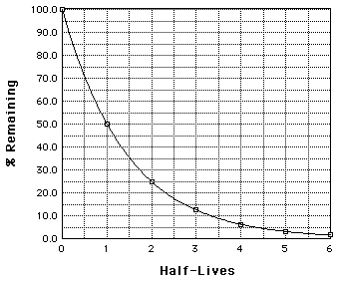
The half-life of a radioactive substance is the average time it takes for half the nuclei present to decay. It cannot be changed for a particular isotope.

Slide 9
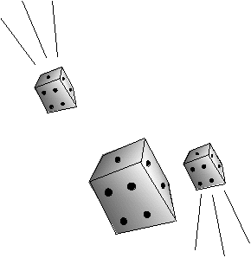
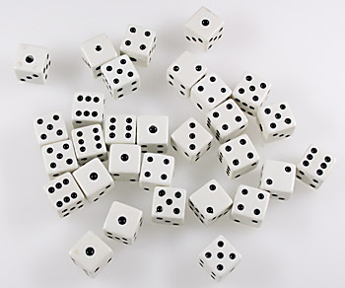
Radioactive decay is a RANDOM process but if enough data is looked at, we can make certain predictions….
Let’s now do the ‘radioactive dice’ experiment together:
Throw No. | No. That land white face up | No. Remaining
Notes:
Practical sheet available with full instructions.

Slide 11
Radioisotopes
A radioisotope has nuclei that are unstable because its nuclear particles are not held together strongly enough.
The largest stable nucleus is an isotope of lead. This is why lead is often found near radioactive rocks.

Slide 12
Half-Life
Higher
The rate of radioactive decay is different for
different radioisotopes.
It depends on the number of nuclei of the
radioisotope present – the more nuclei present
the greater the rate of decay.
The half-lives of different radioactive isotopes vary
from a fraction of a second to millions of years.
IMPORTANT – the half-life of a radioisotope cannot be changed.

Slide 13
Interpreting Graphs
Higher
Using the graph, work out the half-life of the sample.
How can you check your calculation of half-life?
activity in counts per second
80
60
40
20
0
4
8
12
16
20
24
time in days
Notes:
Available on worksheet

Slide 14
Plenary
What can you say about all the isotopes of the elements above lead in the periodic table?
Sita records the count rate from a radioactive source. She takes four readings. They are 130 Bq, 149 Bq, 133 Bq and 142 Bq. Why are the readings different?
HIGHER
The activity of a radioactive sample took 4 hours to decrease from 100 Bq to 25 Bq. What is its half-life?
A radioactive substance has a half-life of 3 hours. How much of it remains after 9 hrs?
Notes:
Answers provided in ‘Answers’ folder

Slide 15
Success Criteria
Grade E | Grade C | Grade A
Recognise how the radioactivity of an object is measured | Recall and describe the relative nature of radioactive decay | Interpret graphical data of radioactive decay and calculate half-life
Understand that radioactivity decreases with time | Explain and use the concept of half-life
Key Words:
alpha • beta • gamma • ionising • decay • half-life • activity • becquerels • GM tube

