Slide 1
Which organelle?
Notes:
Possible starter

Slide 2
Division of Labour and Cell types
How are Prokaryotes and Eukaryotes different?

Slide 3
Lesson 6
Learning Objectives
Success Criteria
Outline the interrelationship between the organelles involved in the production and secretion of proteins
Compare the structure of Prokaryotic cells and the Eukaryotic cells
Draw a flow diagram/construct a comic strip to show the production of proteins
Complete a table to show the comparison between prokaryotes and eukaryotes

Slide 4
Division of Labour
Most organelles are found in both plant and animal cells.
They have the same function in each cell type.
Each organelle in a cell has a specific role within the cell.
This is termed ‘division of labour’
An example of this is in protein synthesis.
Construct a cartoon strip or flow diagram to show how a protein is synthesised, ensuring you highlight the role of each organelle
p14 of the textbook and your organelle cheat sheet will help

Slide 5
The organelles of protein synthesis
Notes:
Teacher notes
It may be worth pointing out to students that the membranes surrounding the organelles in this animation are all based on the same structure – the phospholipid bilayer – but are coloured differently for clarity. In addition, it could be noted that the membrane of endoplasmic reticulum is an extension of the nuclear membrane.
See the ‘Nucleic Acids and the Genetic Code’ presentation for information about DNA, transcription and translation.

Slide 6
Eukaryotic organelles

Slide 7
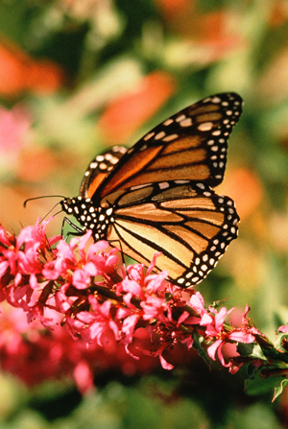
What is a eukaryote?
A eukaryote is any organism consisting of one or more cells that contain DNA in a membrane-bound nucleus, separate from the cytoplasm.
Eukaryotes include:
animals
plants
fungi
a diverse group known as the protists (or protoctists).
All eukaryotic cells contain a large number of specialized, membrane-bound organelles.
Notes:
Photo credit: Jupiterimages Corporation
Teacher notes
See the ‘Classification’ presentation for more information about the relationship between the eukaryote kingdoms.

Slide 8
What is a prokaryote?
A prokaryote is any organism – usually single-celled – whose DNA is suspended freely in the cytoplasm. The word means ‘before the nucleus’.
Prokaryotes can be divided into two groups:
bacteria
archaea.
Prokaryotes have simpler structure than eukaryotes, lacking organelles such as the nucleus, ER and Golgi.
Notes:
Photo credit: Jupiterimages Corporation
Many prokaryotes, particularly archaea, are extremophiles: they are capable of surviving in extreme conditions due to their simple cell structure. This image shows a hot spring in Yellowstone National Park, populated by Thermus aquaticus – a heat-loving bacterium, or ‘thermophile’.
Teacher notes
The archaea are more closely related to eukaryotes than bacteria, but the two groups share such similar cell structure that they can be considered together.
See the ‘Classification’ presentation for more information about the relationship between, and classification of, bacteria, archaea and eukaryotes.

Slide 9
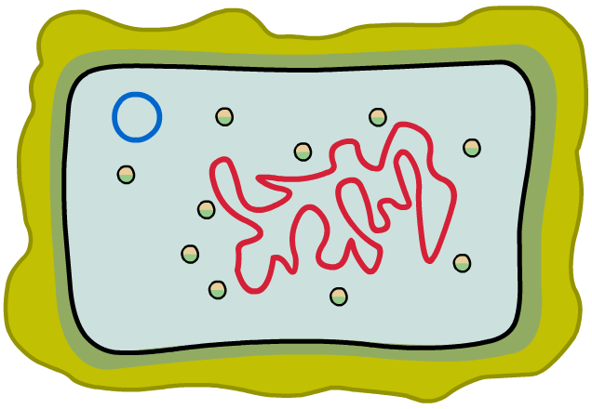
Bacterial capsules
Many pathogenic bacteria are surrounded by a mucous-like protective layer called a capsule.
capsule
cell wall
The capsule protects bacteria from viruses, or attack from a host organism’s immune system, by hiding antigens on the cell surface.
The capsule is usually composed of polysaccharides, and also contains water to protect against desiccation (drying out).
Notes:
Teacher notes
Bacteria surrounded by a capsule include Haemophilus influenzae B, Streptococcus pneumoniae and Salmonella typhi.
The polysaccharides in bacterial capsules are often used in conjugated vaccines.

Slide 10
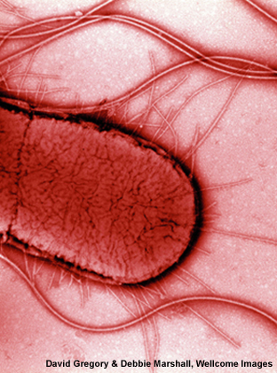
Flagella and pili
Some prokaryotic cells feature one or more flagella. These are long helical tubes extending out of the cell wall, which rotate to provide locomotion.
Flagella are powered by protein motors and can propel bacteria at a rate of more than 50 lengths per second.
Many bacteria also feature pili. These are hollow protein structures used during bacterial conjugation – the transfer of genetic material from one bacterium to another.
Notes:
Photo credit: David Gregory & Debbie Marshall, Wellcome Images
Electron micrograph of Escherichia coli, computer-coloured red. Close-up showing pili (shorter, thinner) and flagella (longer, thicker).
Teacher notes
The flagella of bacteria and archaea are superficially similar, but are thought to have evolved separately for similar functions.

Slide 11
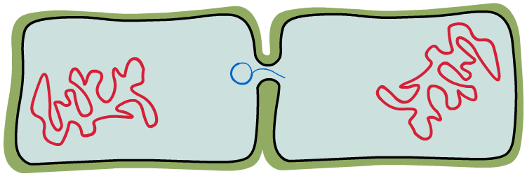
Plasmids
Bacterial cells often contain several plasmids – small continuous loops of DNA.
Plasmids are replicated independently of a bacterium’s genophore (e.g. during bacterial conjugation), and may confer an advantage, such as antibiotic resistance.
pilus draws bacteria together
replication of plasmid
Plasmids are commonly used in genetic engineering to make copies of genes or large quantities of proteins or hormones.

Slide 12
Eukaryotes vs. prokaryotes

