Slide 1
Satellites

Slide 2
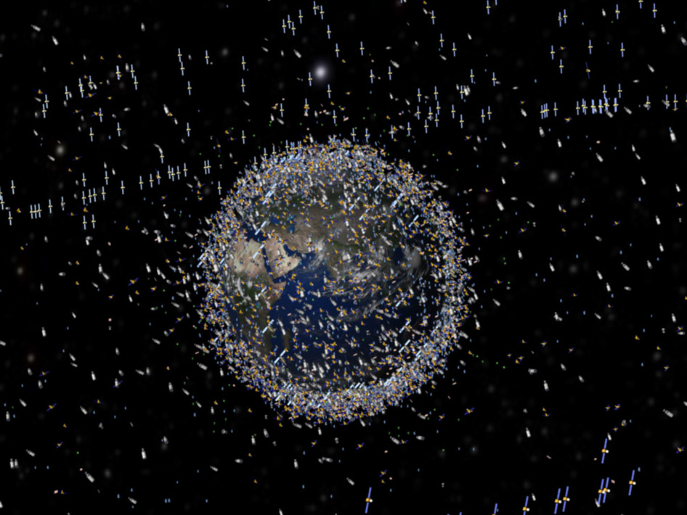
Settler
What is this picture of ?

Slide 3
Learning Objectives
To know what a satellite is
To know some uses of artificial satellites
To understand the differences between polar and geostationary orbits and where they are used

Slide 4
Success criteria
Produce a list of uses of satellites, and correctly identify the type of orbit. (Grade C)
Calculate orbit time and speed for satellites and explain differences. (Grade A)
Draw a scale diagram to determine the number of satellites needed to provide coverage for the entire earth.

Slide 5
Starter - Satellites
On one post it note write down a definition for a satellite
On the second post it note write down as many uses of satellites as you can

Slide 6
Satellites
A satellite is: | Uses of satellites

Slide 7
Artificial satellites
There are two types:
Polar satellites – their orbits pass over both poles
Geostationary satellites – orbit above the equator, staying above the same point on the earth.

Slide 8
Uses of satellites
Make a table with 2 columns labelled “Polar satellites” and “Geostationary satellites”.
Put each of the uses of satellites produced in the starter into the appropriate column.

Slide 9
Communications (including TV)
Weather forecasting
Weather forecasting (long term forecasting)
Imaging earth’s surface
Spy satellites
Scientific research
GPS

Slide 10
Uses of satellites
Low polar orbit
Geostationary orbit
Weather forecasting
Imaging earth’s surface
Spy satellites
Scientific research
GPS
Communications (including TV)
Weather forecasting (long term forecasting)

Slide 11
Copy and complete:
Satellite | Distance from centre of Earth (km) | Orbit time (hours) | Orbital speed (m/s) | Polar or geostationary?
Meteosat | 42180 | 24 | 3067.4 | Geostationary
NOAA | 7279 | 10.7 | 1190 | Polar
What do you notice about distance of the orbits of geostationary satellites compared to polar satellites?
What do you notice about the orbit time for each type of satellite?

Slide 12
Team challenge
Question:
How many geostationary satellites does it take to observe the entire Earth?
Use what you have been given (A4 paper, compass, pencil, ruler, calculator) to draw a scale diagram to help you answer the question.
Information:
Radius of Earth is 6400km
Geostationary orbit is 36 000km above the equator.

Slide 13
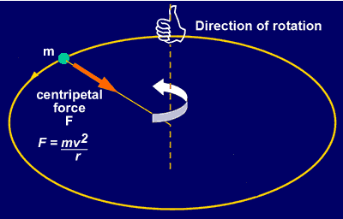
Circular motion
For objects to move in a circle there needs to be a force acting towards the centre of the circle. This force is called the centripetal force.
For satellites moving around the Earth the centripetal force is provided by gravity

Slide 14
Why will a satellite closer to earth have a shorter orbit time?
Close to earth so strong gravitational attraction (large centripetal acceleration).
Shorter orbit.

Slide 15
Homework
Homework 1 on Space exploration and satellites

Slide 16
Learning Objectives
To know what a satellite is
To know some uses of artificial satellites
To understand the differences between polar and geostationary orbits and where they are used

Slide 17
Success criteria
Produce a list of uses of satellites, and correctly identify the type of orbit. (Grade C)
Calculate orbit time and speed for satellites and explain differences. (Grade A)
Draw a scale diagram to determine the number of satellites needed to provide coverage for the entire earth.

Slide 18
Plenary - Key learning
Satellites are .......
The main differences between polar orbits and geostationary orbits are ...........
Two uses of a polar orbit satellite are .......
Two uses of a geostationary orbit satellite are ......
The further a satellite is from the earth the .............. it moves

